Slide 1
Caring Neighbourhoods
Department of Care, Flemish Government
ENSA Network - 29 June 2023

Slide 2
Meaning ‘Caring Neighbourhoods’
“In a caring neighbourhood conditions are met so that people, regardless of age and large or small support needs in multiple life domains, can (continue to) live comfortably in their home or familiar neighbourhood. It is a neighbourhood where young and old live together, where people feel good and safe, where quality of life is central, where residents know and help each other, where people and families with large and small support needs receive support and where services and facilities are accessible and available.”

Slide 3
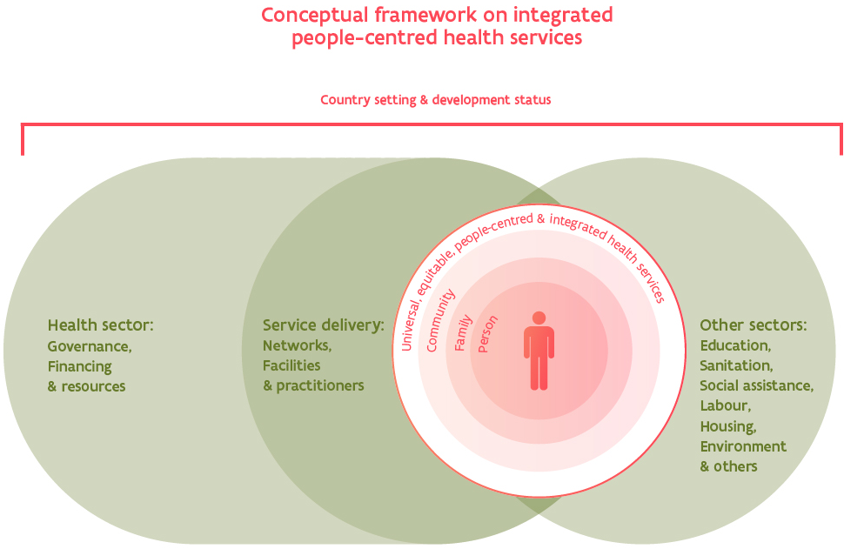
Vision on Caring Neighbourhoods
Based on model on integrated people-centred health services of the WHO
Health and well-being
Focus on quality of life
Caring neighbourhood indispensable link in this model towards integrated care
Notes:
The person is at the centre of this model and calls on a mix of support -> so a caring neighbourhood is an indispensable link toward integrated care.
Focus lies on quality of life → therefore we need a connection in caring neighbourhoods between wellbeing and health and other sectors…

Slide 4
Goals of Caring Neighbourhoods
Participation and inclusion
  Building up a social network, solidarity, caring coexistence
  Social encounters → knowing each other → small support
Connecting informal and formal care
  Early detection of vulnerable people + better access to professional care
  Support informal care givers
Intersectoral collaboration that focuses on prevention, health promotion, provision of integrated care and support with a focus on quality of life
  Collaboration between health and wellbeing + housing, spatial planning, youth, sports, education, etc
Notes:
Why are we investing in caring neighbourhoods?
Participation and inclusion → it is not a cost cutting operation
Connecting…
Intersectoral collaboration that focuses on prevention, health promotion, provision of integrated care and support with a focus on quality of life
This is the core of a caring neighbourhood.Welfare and health challenges are such that organisations need to work together to achieve the best, integrated care for people.From Flanders, we set the framework. But we leave it to the neighbourhood (neighbours and formal care providers) to set priorities on which they want to focus.
These priorities can be very different: for example: more encounters, better support for informal carers, combating loneliness, combating mental problems among young people, but it could therefore just as easily be about building a footpath or creating a meeting place such as a community garden.

Slide 5
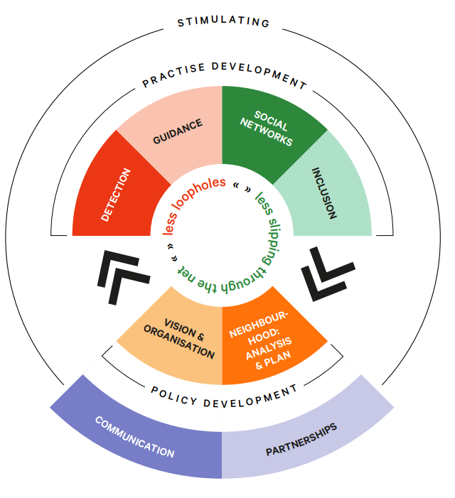
Frame of reference with 8 building stones
Developed by the Flemish Association of Cities and Municipalities (VVSG)
Further elaborated and tested by SAAMO (community building)
…Tool which can be used in other regions and countries
Brochure in English on our website

Slide 6
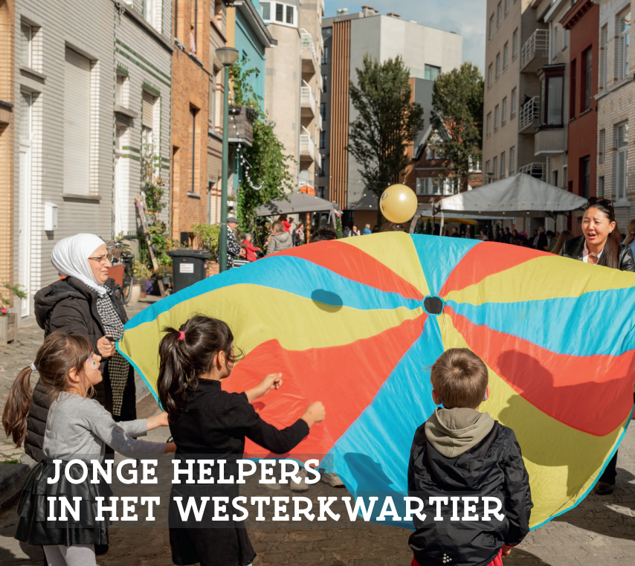
Situation
  Quarter in Oostende
  Diverse population (different cultures and languages)
  25% age under 18
  6 places where people meet in the quarter (social grocery, two youth organisations, community health center, home for elderly, organisation diversity)
Investing in connection between people and organisations
Connection with the school -> school “informal care giver friendly”
  Detection of 40 young informal care givers

Slide 7
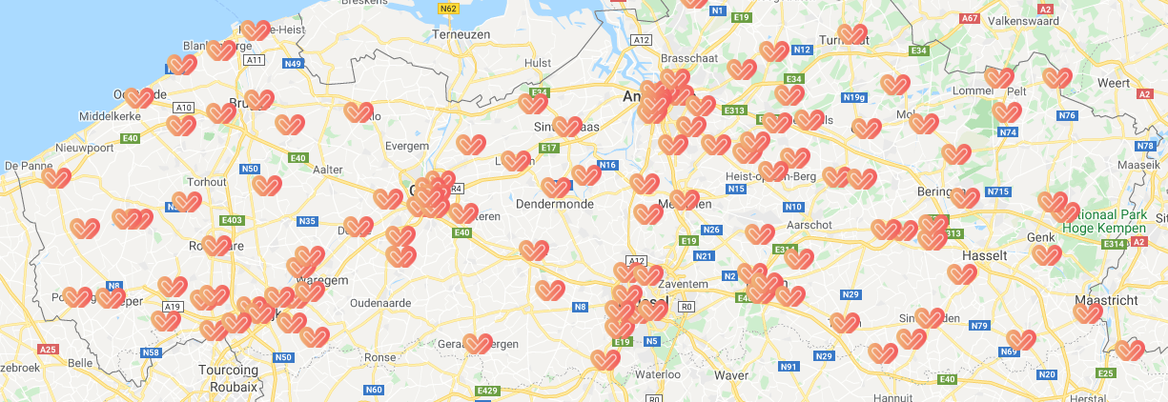
Flemish policy on Caring Neighbourhoods
Project call in 2021
132 caring neighbourhood projects started March 1, 2022, for two years
Projects initiated by municipalities and health and wellbeing organisations
Local partnerships in which local residents cocreate

Slide 8
Flemish policy on Caring Neighbourhoods
Projects supported by a consortium, coordinated by King Baudouin Foundation
  More than 15 different colleges, universities, research centers and midfield
  Coaching and trainings on key topics (neighbourhood analysis, theory of change, participation, inclusion, intersectoral collaboration, healthy public space, asset based community development, etc)
  Flanking research - Policy Research Centre for Welfare, Public Health and Family
  Vrije Universiteit Brussel (VUB), Thomas More and the University of Antwerp
  Aim: Developing practical tools to support neighbourhoods in developing a sustainable caring neighbourhood and giving concrete policy recommendations
Scaling up number of caring neighbourhoods → inspire + inform wider work field
Stakeholders meeting

Slide 9
Flemish policy on Caring Neighbourhoods
Quick wins + first building blocks towards structural policy
Work together with the WHO
Share findings for international public in a symposium on 3 May 2024 in Leuven

Slide 10
Caring Neighbourhoods in Flanders
Website www.zorgzamebuurten.be
  One page with information in English
    Flemish policy
    Publication "Less loopholes, less slipping through the net“ (SAAMO)
      how to get started with the framework with 8 building blocks?

Slide 11
Thank you for listening!
Questions?
Contact details
Isabelle Van Vreckem
Project Coordinator Caring Neighbourhoods policy
Department of Care, Flemish Administration
E-mail: isabelle.vanvreckem@vlaanderen.be

