Slide 1
Be Coming Home in Sint Gillis
29 juni 2023
ENSA meeting

Slide 2
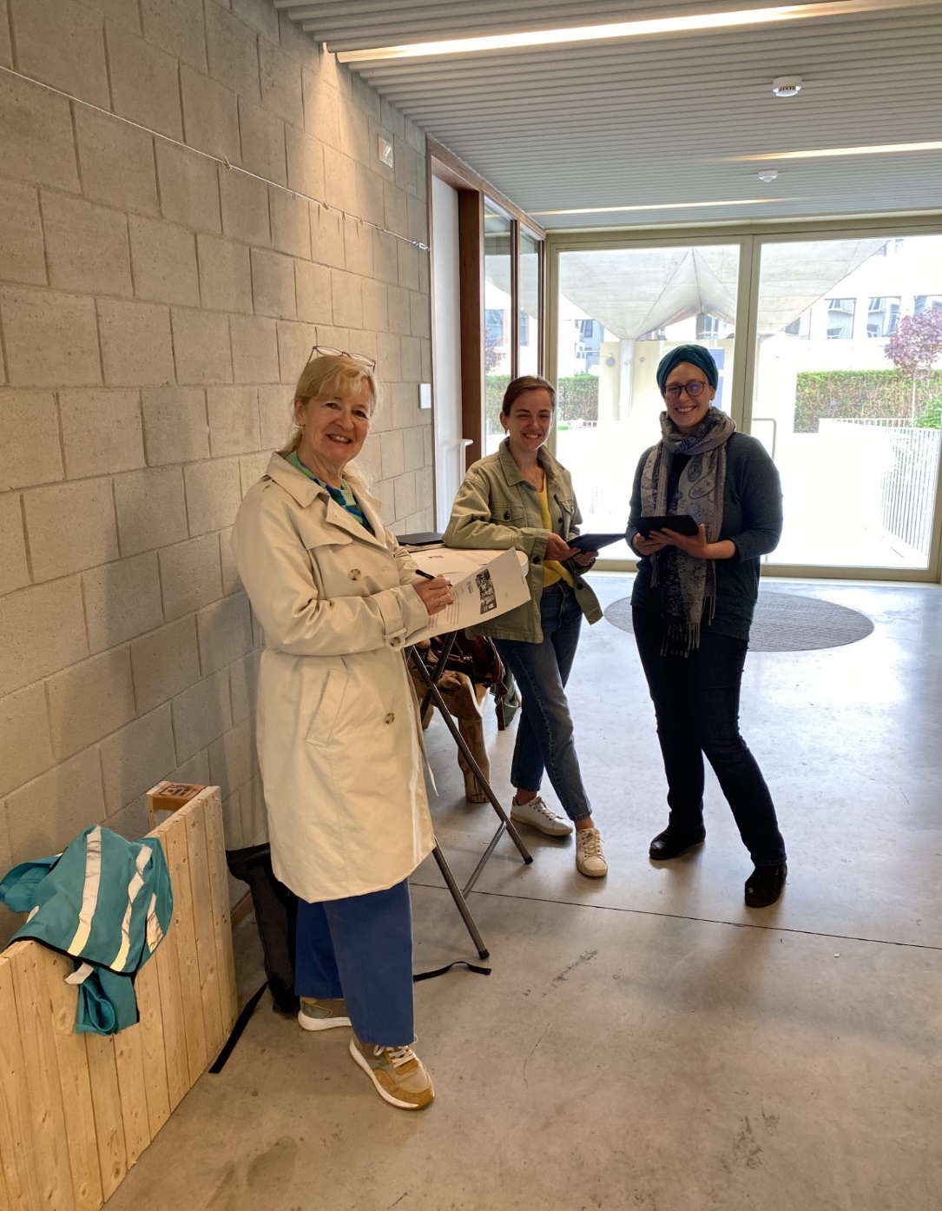

Team Be Coming Home - Caring Neighbourhoods Brussels
Sarah van Solentra
Kim en Simonne van KC Gezinswetenschappen Odisee

Slide 3
Overview project
Step 1: interviews formal and informal stakeholders (03/22-10/22)
Step 2: actions (11/22-12/23)
  Resilient women’s groups at Femma Quartier
  Resilience and multilingualism through the Library
  Parent involvement in Primary School Balder
Step 3: final event: connecting informal and formal services (03/24)

Slide 4
Steakholders in the neighbourhoods Hallepoort en Bosnië (St.Gillis)

Slide 5
Overview project
Profile of residents
Living close to each other, as a tenant in an apartment; relatively high number of social housing units in Bosnia-area
Show great diversity in terms of origin, a quarter come from a European country (club of 15)
Almost half of the households consist of 1 person
In 5 years time, almost half of the population is new to the district, and a quarter new to Brussels (arrival districts)
The inhabitants show a vulnerability in socio-economic terms: high unemployment rates, low income
It is a relatively young population (larger group of newcomers around the age of 30)

Slide 6
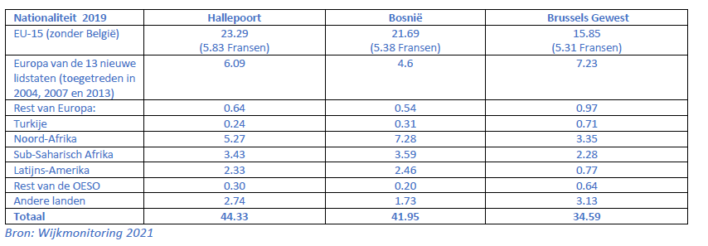
(Super)diversity (%)

Slide 7
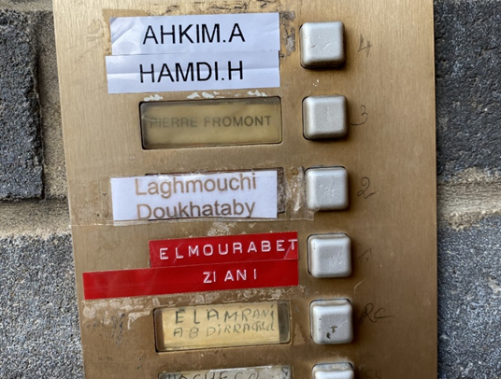

Hallepoort en Bosnië = an arrival and transit area
impact on the quality of life in the neighbourhood and on the psychological well-being of the residents

Slide 8
Interview (n=30) formal and informal stakeholders
Results
poor housing
child poverty
lack of green spaces
social isolation of vulnerable residents
increasing street crime
insecurity, especially for young girls (12-18 years)
difficult access to the (formal) support offer, especially for certain population groups (newcomers, non-native speakers, homeless people, isolated people, etc.)
Notes:
We identified informal and formal care and welfare organizations in the area and approached them for interviews. We had our assumptions, but we needed concrete data from the neighborhood itself to draw up an action plan. Shortly after the start of the project, a construction worker joined the team. As a resident of Sint Gillis, our community worker Asena mapped the neighborhood to identify and reach informal and grassroots organizations, and after a while also key figures in the neighborhoods.

Slide 9
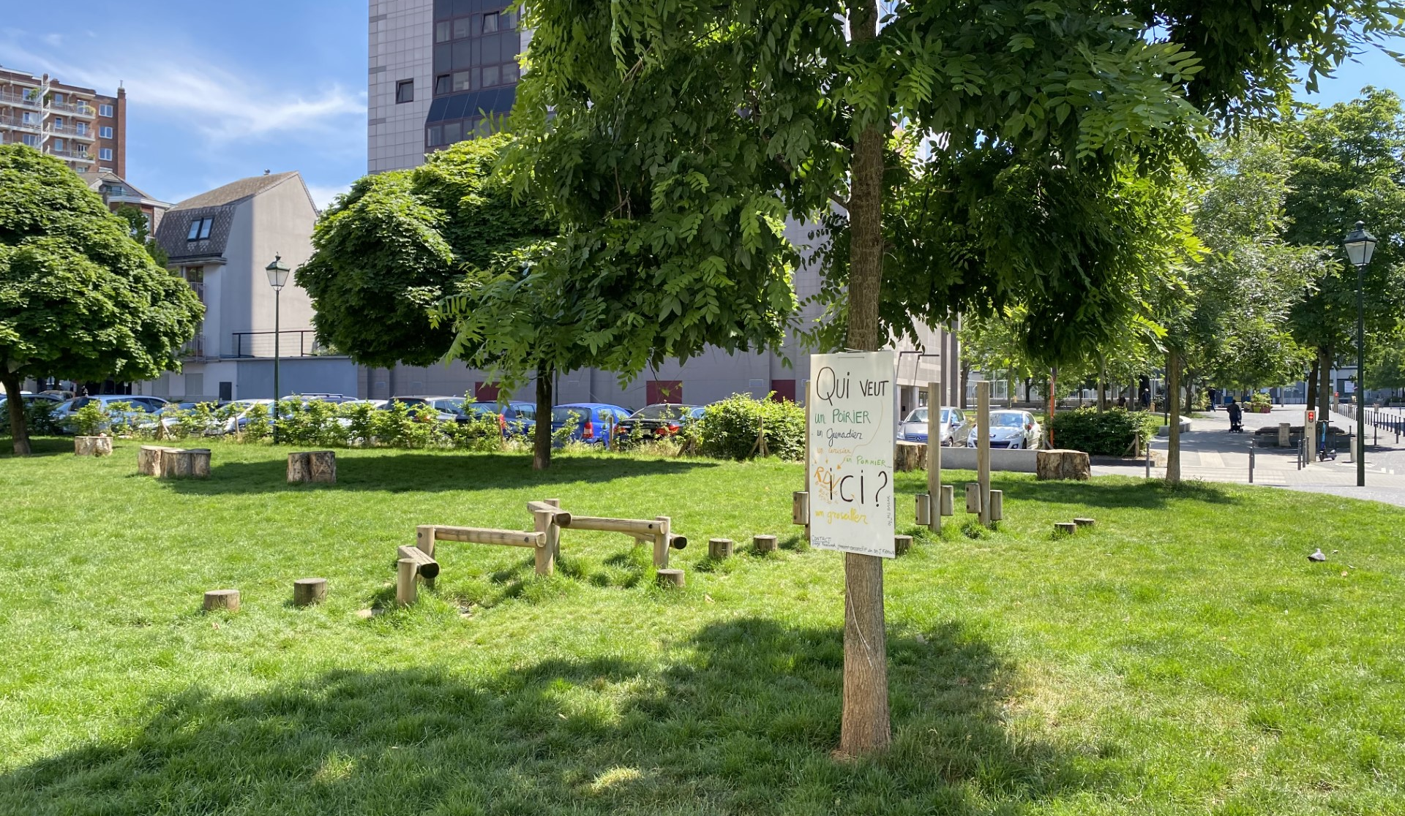

Slide 10
Theory of Change
Our aims:
vulnerable and at the same time resilient residents who previously lived in social isolation and who have no or limited (access to) social networks, have a greater mental well-being.
where necessary/useful, they find their way to welfare and care facilities for their support needs
and these facilities enhance their resilience through a diverse-sensitive approach.
formal and informal actors are connected and form a caring neighbourhood together with the residents.

Slide 11

To weave a web in the neighbourhood

Slide 12
How?
diversity sensitive approach of resilience
connecting the stakeholders and at the same time make them aware of the importance of resilient action by local residents and strengthening this
welfare and care actors will become more aware of the risks of learned helplessness, and will act (even) more from an emancipatory perspective

Slide 13
How?
Neighbourhood participation and inclusion: via focus groups on resilience using the CBC methodology (Community Based Consultation, expertise of Solentra)
  Example: Femma Quartier
Connection of informal and formal care
  Feedback results stakeholders neighbourhood analysis with focus on resilience (goal = paradigm shift)
  Dissemination of the insights from the focus group discussions with the residents
  On request, formal and informal welfare and care actors can call on our expertise on diverse-sensitive action and transcultural care
    Example:
Integrated care : intersectoral cooperation (different life domains) Example:‘Resilience and multilingualism’

Slide 14
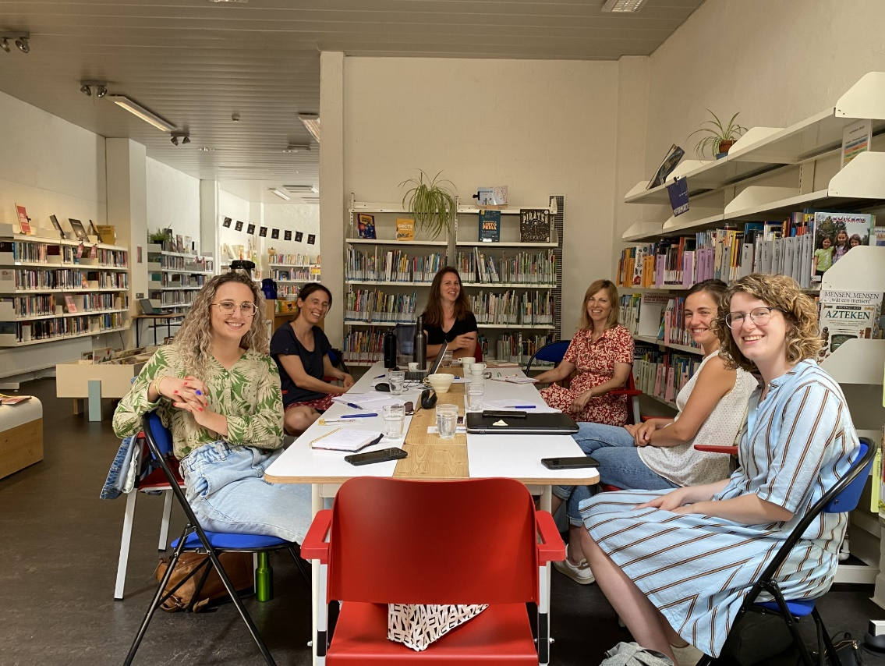
Resilience and multilingualism
Focus groups steakholders: giving back the results analysis to professionals Library
Co-creation action ‘resilience and multilingualism’ : free time, education, social-cultural work, work…
Actors: Experts ‘Foyer’ PIM, Library, Imersie-school (Fr), Balder (Nl)
Together for a positive attitude towards Multilingualism (children, parents, teacher, key-figures from the informal steakholders)
Sustainable
Notes:
1. Library= meeting point in the neighbourhood and a safe space for children and families
2. super diversity= challenge for inclusion in the library
Conclusion: Zo spelen we enerzijds preventief in op de noden van de kinderen (thuistaal en schooltaal als gelijkwaardig zien én verbinding tussen de kinderen stimuleren), sensibiliseren leerkrachten en bibmedewerkers over de kracht van meertaligheid en hoe hiermee om te gaan en zetten we sterk in op participatie en inclusie door ouders te verbinden met elkaar, te verbinden met de bib en met de school. Gelijktijdig worden bibmedewerkers gevormd om dit aanbod zelfstandig te kunnen blijven aanbieden op lange termijn. Daarbij denken we ook na om vrijwilligers hierin op te leiden en denken we specifiek aan ouders die we hebben ontmoet in de Balderschool

Slide 15
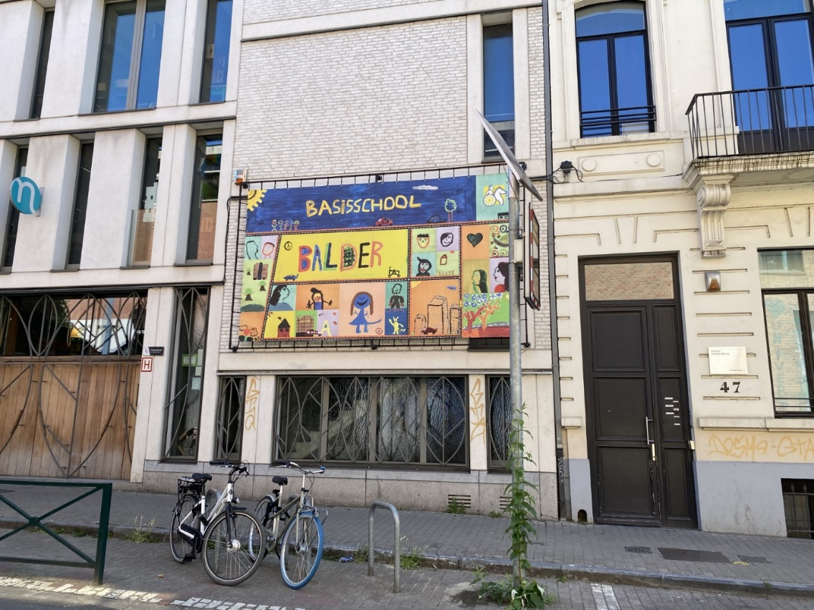
School Balder
Participation of parents: interviews
Focusgroup parents (september 23)
  Idea: a social worker from CPAS in the school
  Summer school
  Leisure activities for childen and parents…….
Actions neighbourhood (by parents)
Connecting with ‘resilience and multilingualism’
…………………………….
……………………….

Slide 16
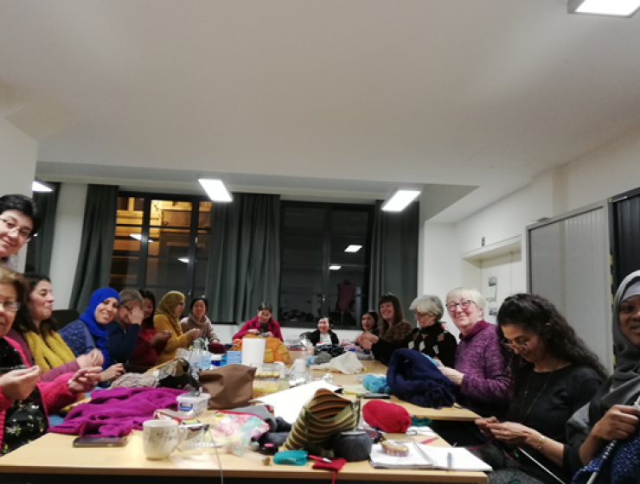

Femma Quartier
Two group sessions (untill now) focusing on (post)migration and well-being
Inspired by CBC (community based consultation), expertise of Solentra
Diversity-sensitive approach to resilience
Connecting participants via ‘key-figures’
Connecting formal and informal actors
Sustainability: tool for future group sessions on the resilience of migrant women
…..

Slide 17
Work to do
Feedback interviews about the project with key stakeholders (e.g. security services from the commune, religious communities, GAPPI, Le Petit Vélo Jaune, ……. )
Question= is a paradigmashift about to happen?
Notes:
Paradigmashift: van ‘hulpeloos’ naar ‘veerkrachtig’

Slide 18
Thanks

