Slide 1
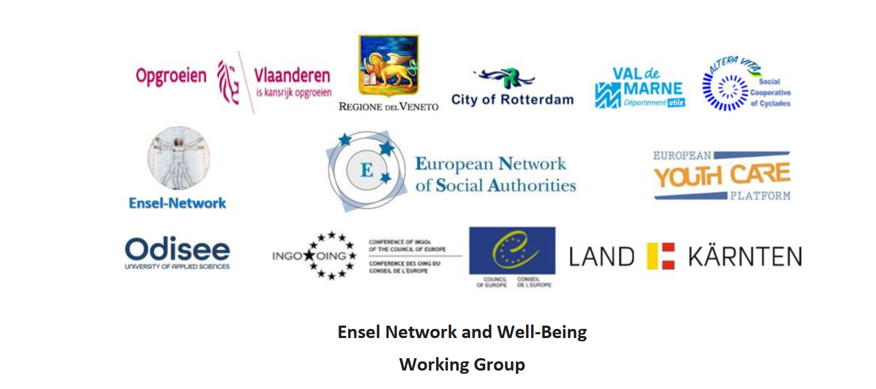
M
ENSA Working Group Youth, Child, and Family/Youth Care Platform, ENSEL NETWORK
BRUSSELS 29 June 2023
Miltos Sakellariou
Coordinator ENSA WG-Well Being & Social Emotional Learning
Family Therapist, MSc Counseling Psychology
Chair of Social Cooperative of Cyclades
Altera Vita

Slide 2
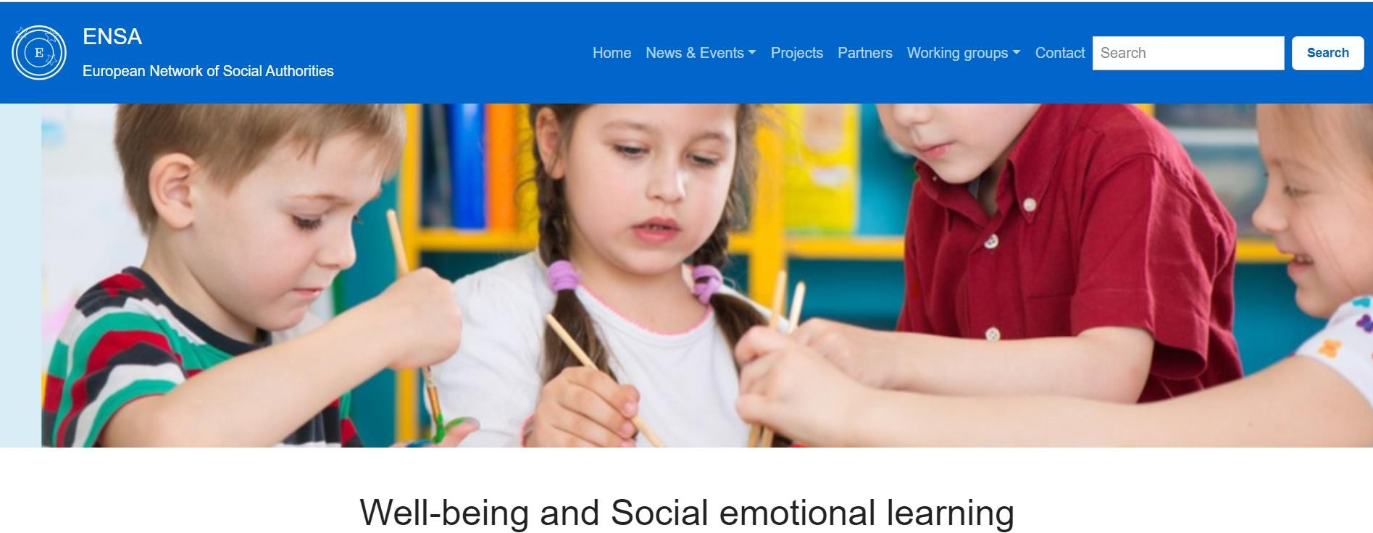
• ΕΝSEL Network and Wellbeing Working group
• ALTERA VITA with Universities, Schools, and Organizations working on ERASMUS + projects, for the last few years and continuing, has created educational tools for Social Emotional Learning, and they have established an informal network for Social Emotional Learning, ENSEL NETWORK.
ΕΝSEL Network and ENSA-Wellbeing Working group
ALTERA VITA with Universities, Schools, and Organizations working on ERASMUS + projects, for the last few years and continuing, has created educational tools for Social Emotional Learning, and we have established an informal European Network for Social Emotional Learning, ENSEL NETWORK.
https://en-sel.eu

Slide 3
European Network for Social Emotional Learning
ENSEL (European Network for Social Emotional Learning) aims to implement life skills in a holistic way, helping young people exercise their fundamental rights in the home, school, class and community.
ENSEL NETWORK strives to provide school staff with the skills, knowledge and confidence that can help them establish an effective student Peer Support scheme in their schools and develop their students’ social and emotional skills, and to involve also families and the whole community.

Slide 4
OBJECTIVES AND ACTIVITIES
The main objectives of the new thematic group for Wellbeing and Ensel- Network :
1. To coordinate actions and initiatives at the European level and develop partnerships across Europe
2. To campaign and advocate for a common European strategy for life skills, especially for Social and emotional competencies in Europe and to monitor and influence policies at the national and European levels for schools, Universities, Communities, and Organisations.
3. To produce and promote the exchange of good practices, enforce capacity building and provide tools and training to professionals working in the field.
4. To raise awareness among the public and empower children and young people as well as parents, teachers and stakeholders professionals, on how to achieve implement Life Skills in a Holistic approach in their communities for the well-being.

Slide 5
LIFE SKILLS-IMPEMENTATION IN OUR COMMUNITIES
ENSEL NETWORK conceives as an “umbrella organization”, providing members with a platform and framework to join forces, exchange good practices and materials, and thus develop common actions to motivate all parties involved in Life Skills.
Life skills include self-awareness, self-control, self-esteem, self-respect and self-reflection.
Interpersonal life skills include effective communication, cooperation, teamwork and problem-solving abilities, respect for similarities and differences, appreciation, empathy, trust and love.

Slide 6
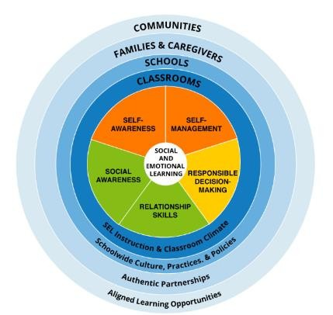
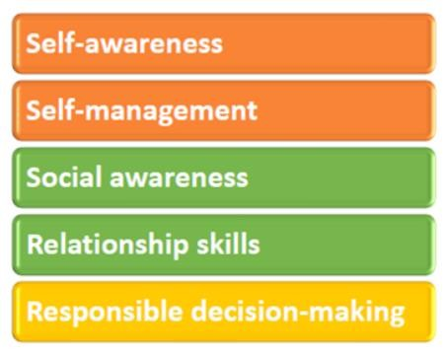

Slide 7
E-learning –ENSEL PLATFORM
ENSA NETWORK-VENETO REGION -ITALY ENSA WORKING GROUP FOR SEL AND WELLBEING
ALTERA VITA -SOCIAL COOPERATIVE OF CYCLADES-GREECE
SOCIETY FOR THE PROTECTION OF MINORS OF SYROS-COURT OF APPEAL -SOUTH AEGEAN GREECE
ΤΟPUNT GENT - BELGIUM
UNIVERSITY OF ROTTERDAM –HOLLAND
UNIVERSITY OF EVORA- PORTUGAL
UNIVERSITY OF GRANADA -SPAIN
UNIVERSITY OF VALENCIA -SPAIN
UNIVERSITY OF CANAKKALE-TURKEY
UNIVERSITY OF BUCHAREST- ROMANIA
UNIVERSITY OF LODZ-POLLAND
IMAGINE IF -UNITED KINGDOM
SKOLUTVECKLARNA SVERIGE AB SWEDEN
DOUBLE HELIX - UNITED KINGDOM
CIPFP- MISERICORDIA CENTRO INTEGRADO PÚBLICO DE FORMACIÓN PROFESIONAL - SPAIN
FEMXA FORMACION SLU- SPAIN
"AROGI" ASSOCIATION OF VISUALLY IMPAIRED PEOPLE OF CYCLADES- GREECE
4TH EXPERIMENTAL ELEMENTARY SCHOOL OF SYROS-GREECE
TARSUS CHAMBER OF COMMERCE AND INDUSTRY - ΤURKEY
HIGH SCHOOL OF DORTMOUTH-GERMANY

Slide 8
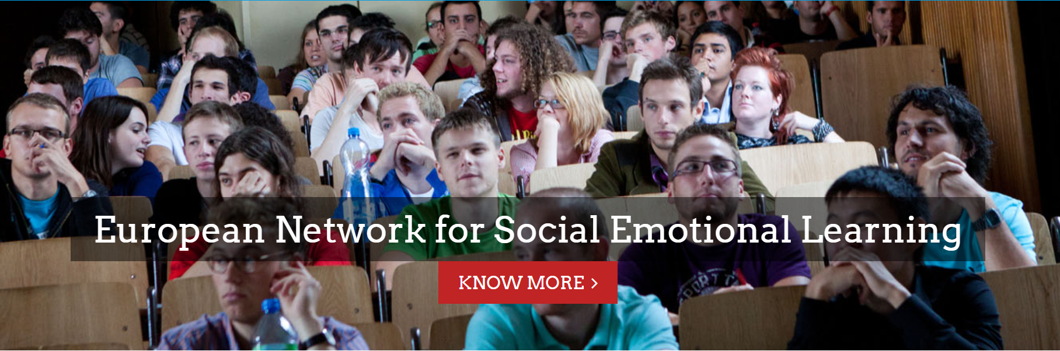
Log in
Home History Vision & mission Organisations Projects

Slide 9
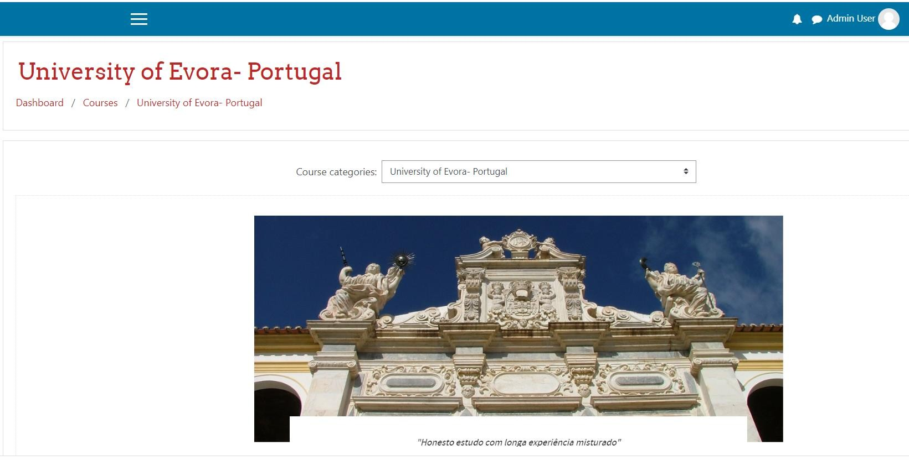

Slide 10
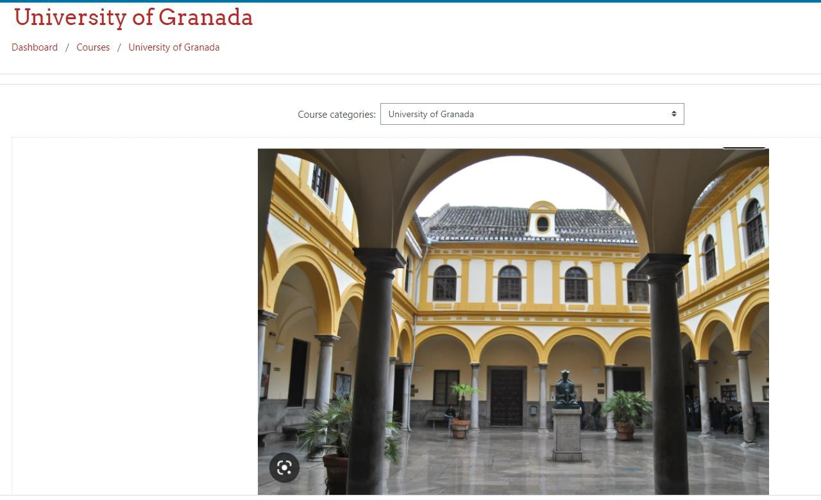

Slide 12
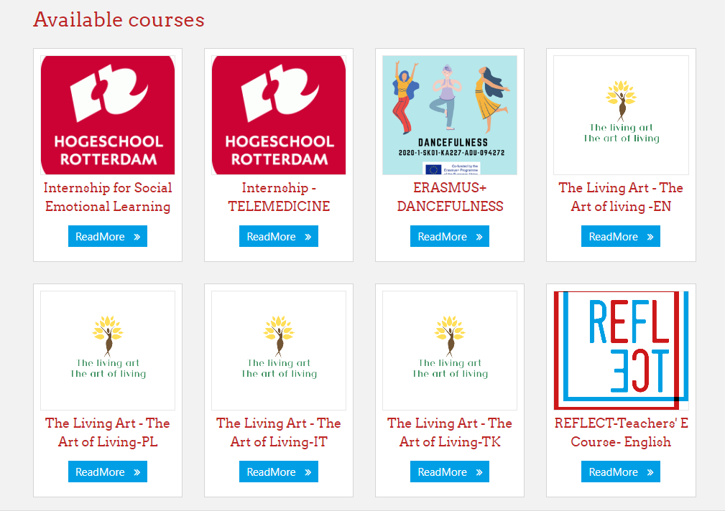

Slide 14
ERASMUS + COMPUSEL

Slide 16
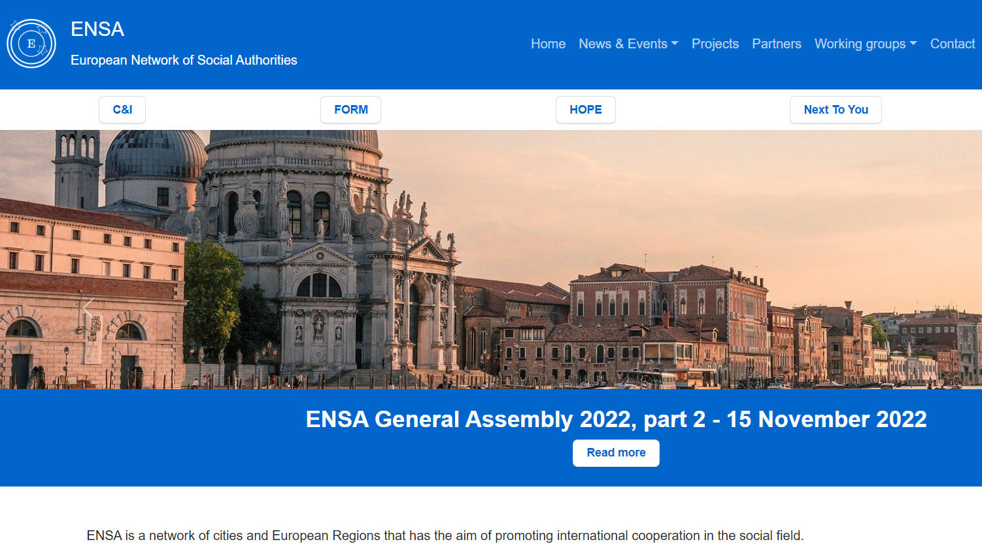

Slide 17
ENSA WORKING GROUP FOR SEL & WELLBEING
At the annual General Assembly of the ENSA network on November 15, 2022, in Venice, a new working group for the promotion of well-being and the implementation of Social Emotional Learning in Europe has been established.
The present coordination of the thematic ENSA working group- Wellbeing and Social Emotional Learning - is led by the Social Cooperative of Cyclades, Greece.
Altera Vita is a scientific research Centre that implements education and awareness programmes, in the areas of Social Economy, Health Promotion, Organic Farming, Environment and Sustainable Development, the Arts and Culture, Pedagogy, Psychology, and New Technologies.

Slide 19
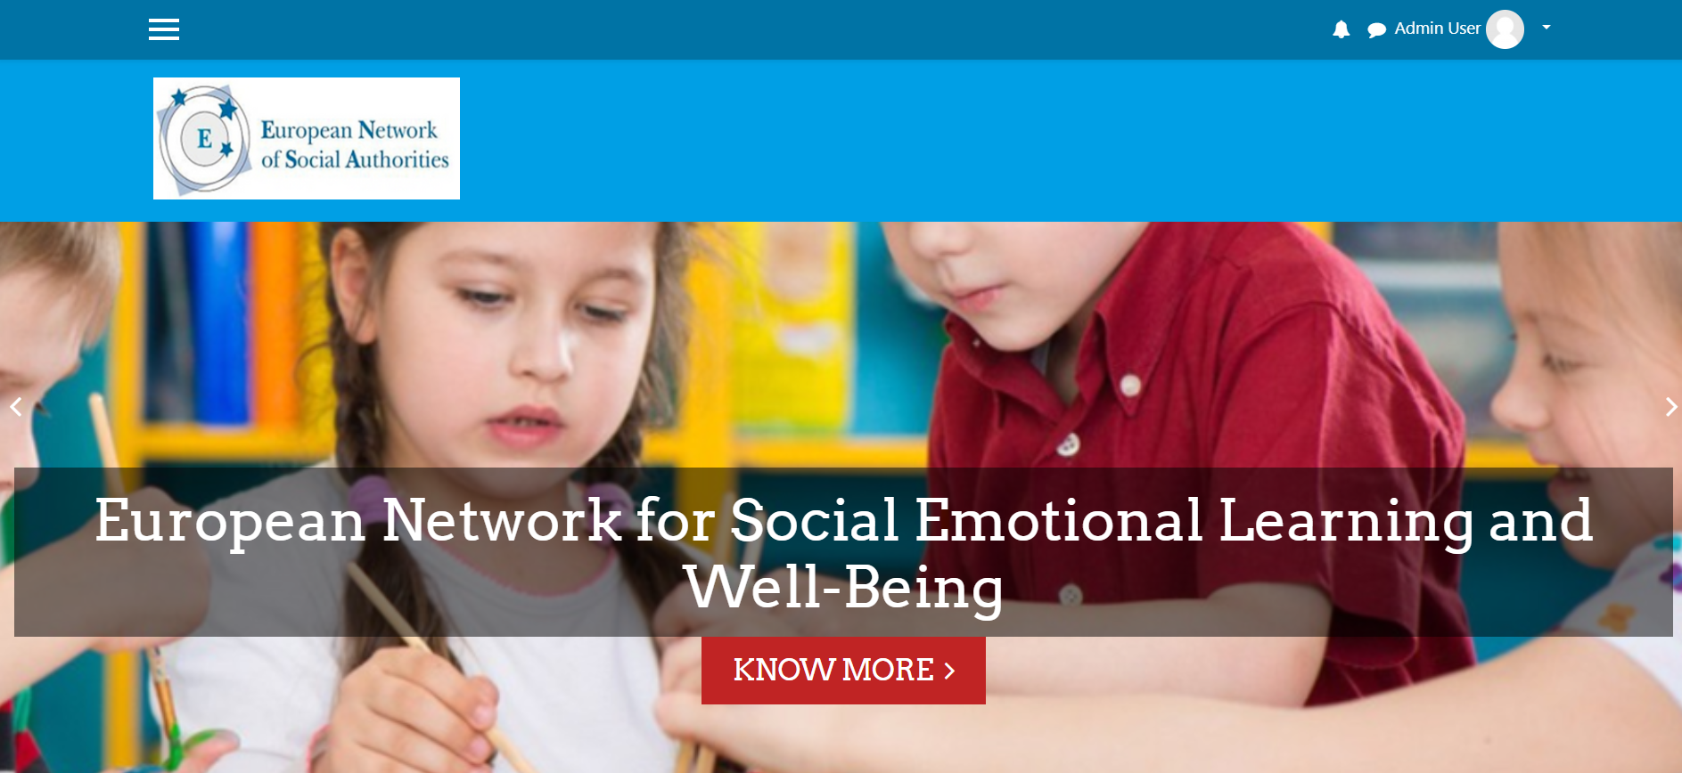

Slide 20
ENSEL PLATFORM- PRESENTATION OF PROJECTS
ENSEL NETWORK: https://en-sel.eu/
The living Art-Art of Living: https://livingarterasmus.wixsite.com/livingart
REFLECT: https://reflectproject.wixsite.com/site
COMPUSEL: https://compuseleu.com/
RED: https://erasmusredproject.wixsite.com/red-project
DANCEFULNESS: https://dancefulness.eu/
Participation
If you are interested to participate in this working group of ENSA, please fill out the following form
Contact information:
https://forms.gle/uCCqBiBo9oUpvtcX6

Slide 22
Thank you!!

