Slide 1
Konekti
An inter-sectoral cooperation to support children and their families in vulnerable situations

Slide 2
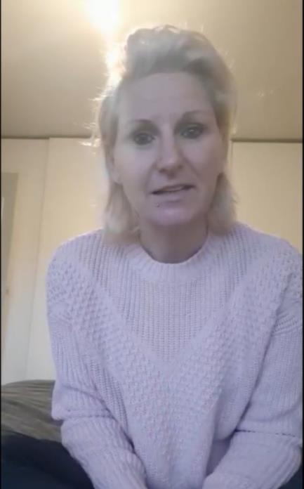
Testimony of
a mother
01

Slide 3
01

Slide 4
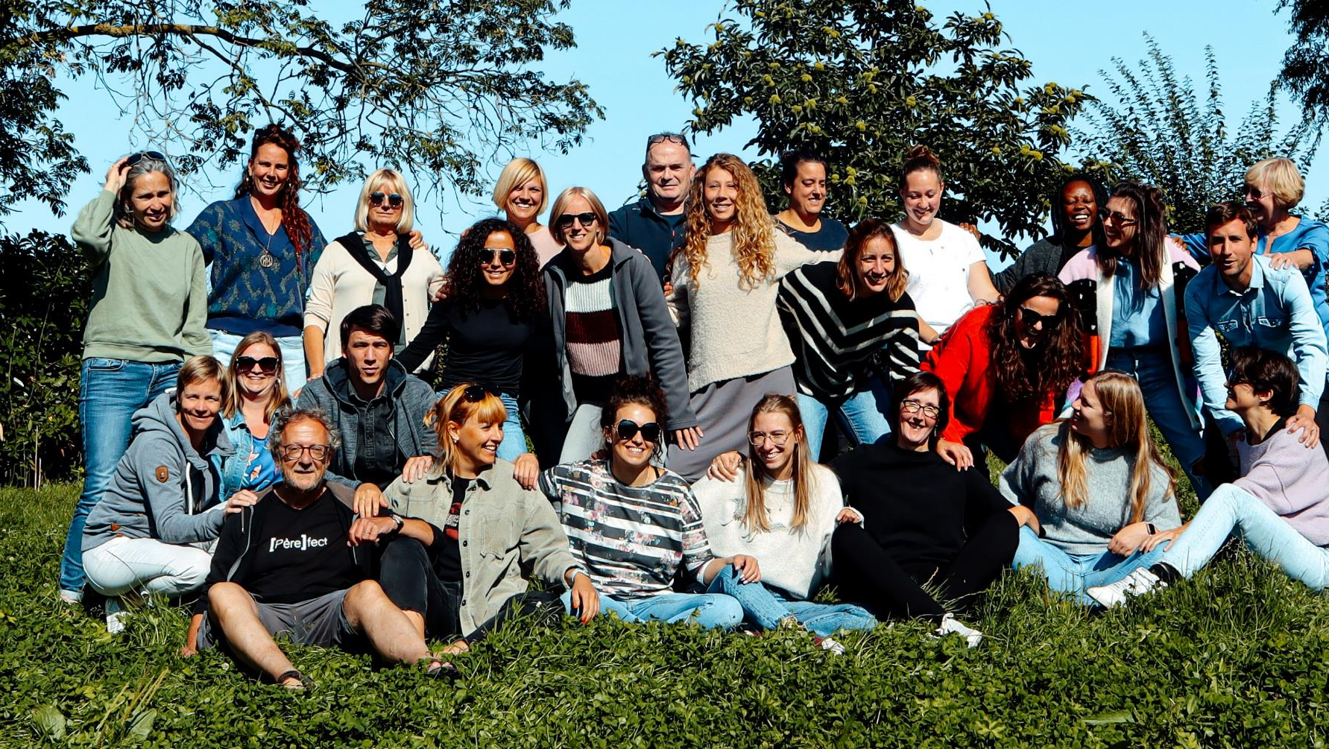
Konekti
powered by W13
02

Slide 5
Connecting
sectors
03

Slide 6
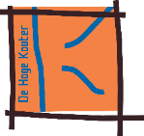
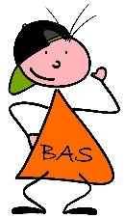
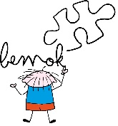
Intersectoral
cooperation
04

Slide 7
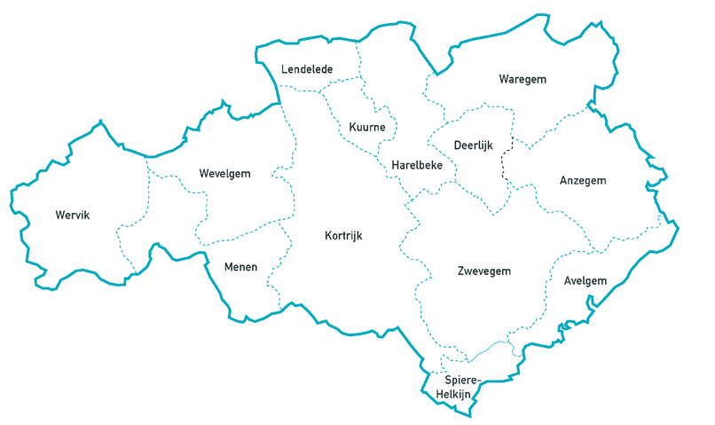
W13
Regional association of
14 Public Centres of Social Welfare
(local authorities)
1 Reginal Centre for Social Work
Joint social and welfare policy for the region
Focus on people in the most vulnerable situations
Connecting all stakeholders and partners
Facilitating coordination and cooperation
05

Slide 8
Complex situations
06

Slide 9
07

Slide 10
08

Slide 11
09

Slide 12
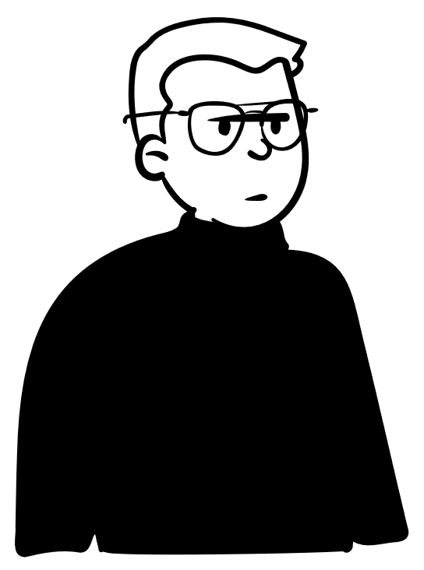
10

Slide 13
1 Family 1 Plan in Flanders
11
Notes:
https://www.xn--ngezin-nplan-9dbaha.be/#/lessons/mkQgb64OQ0CW5jpBmkF4-hNTuoW0C7Gg

Slide 14
Principles of
1 Family 1 Plan
Empowerment = the strengths in the family
Other role of the professional
Ownership by the family
Equality
With the families and the professionals
Network
Social and professional
12

Slide 15
Way of working with families
Where children and their families are
Out of the box
Short time, long term result
1 Family plan
Own strengths
13

Slide 16
Organization
One physical location
Presence of other regional partners
Support
Questions are assigned at random
Not according to background or expertise
Pattern of return
Family coaches are outsourced 2 to 4 years
Sharing and exchange of expertise
Generalist
Magic
Specialist
14

Slide 17
Proof of value
In 4 years time (2018-2022)
1.122 families were supported by Konekti
200 families a year = the original aim
Appreciative inquiry (2019-2020)
Sample of the supported families
Average score of 9.4 out 10 for satisfaction
15

Slide 18
Contact details
Websites
https://welzijn13.be
https://konektizwvl.be
Loes Verdru, Project Manager Konekti, W13
Loes.verdru@welzijn13.be – +32 478 56 74 60
16

