Slide 1
AgeTech Revolution
Oscar Zanutto, ISRAA, Treviso
faber@israa.it
Meeting ENSA Elderly and Disability Group
27th June 2023

Slide 2
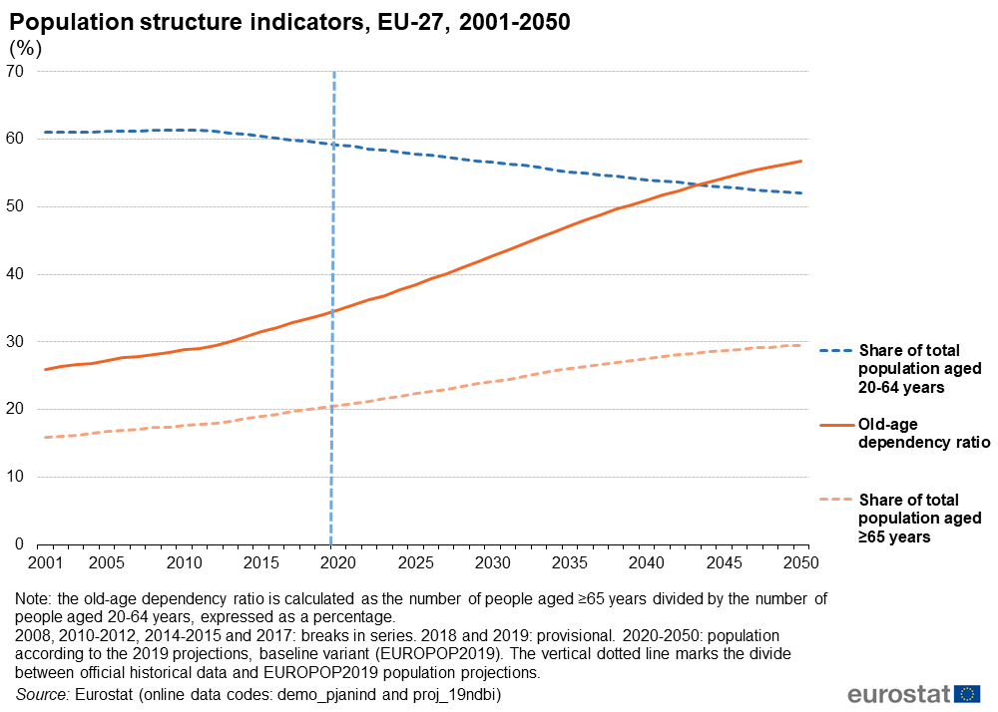
What is the challenge until 2050?

Slide 3
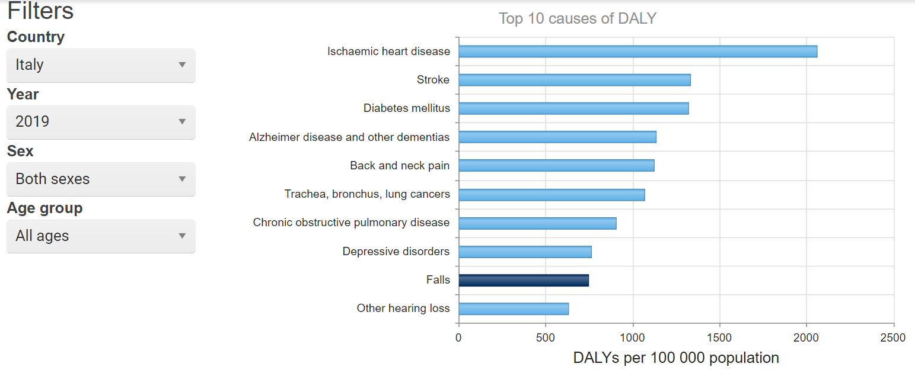
How are we getting there?

Slide 4
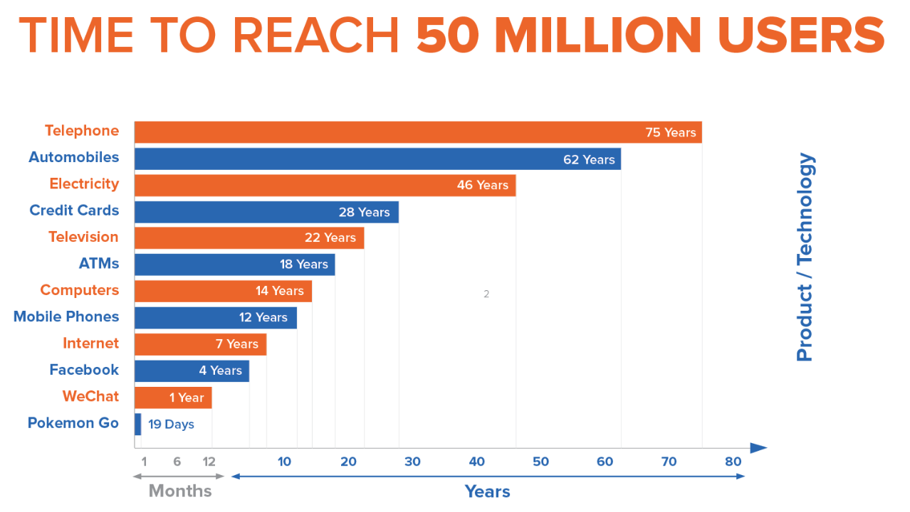
The speed of technology implementation

Slide 5
So, which solutions to meet the challenge of ageing?

Slide 6
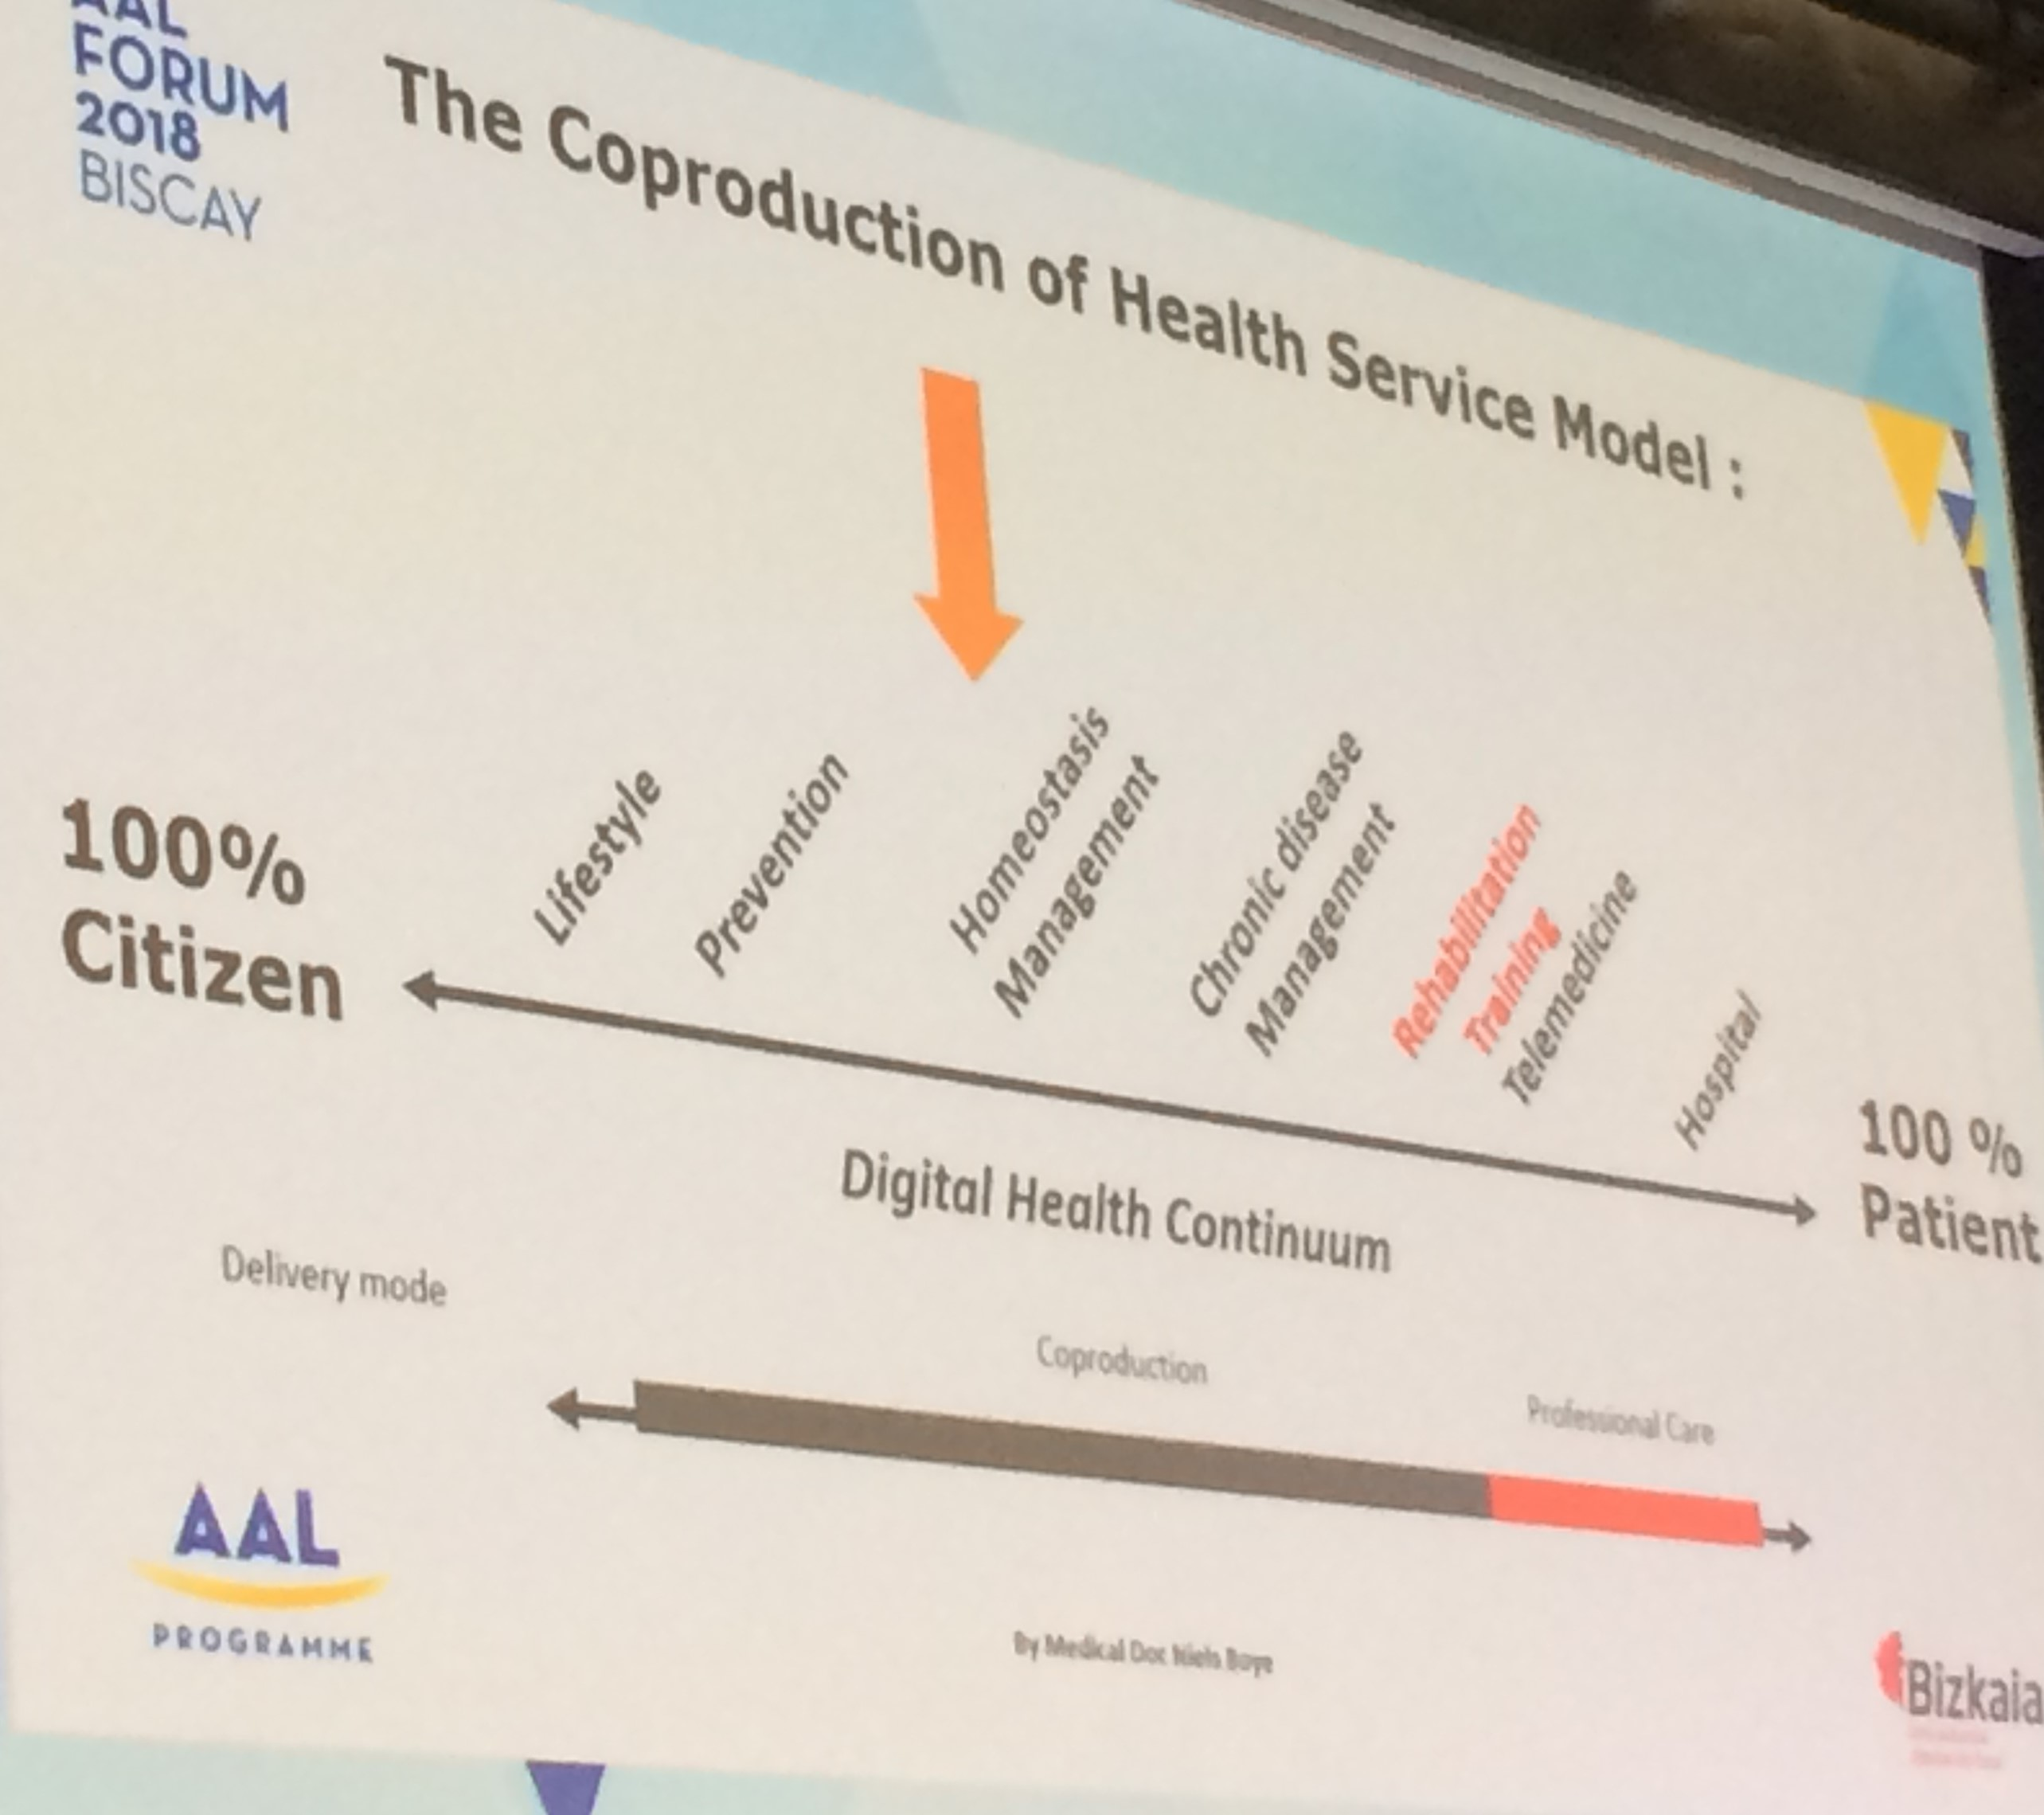
Health co-production model
Chronic disease
management
Homeostasis management
Rehabilitation
Training
Telemedicine
Hospital
Prevention
Lifestyle
100%
Citizen
Digital Health Continuum
100%
Patient
Coproduction
Professional care

Slide 7
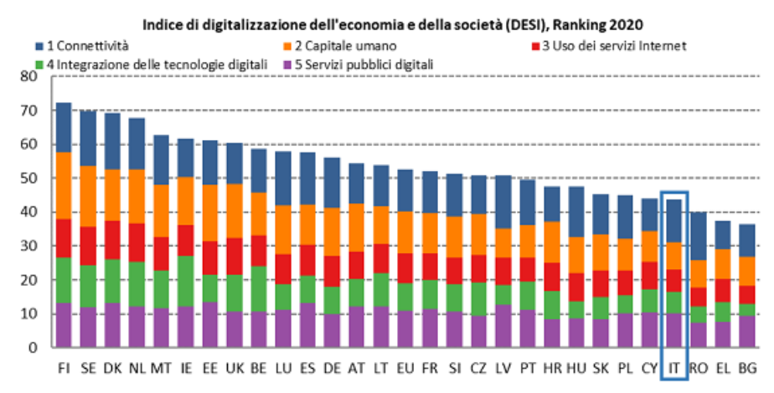
Italy and technology:
DESIE Digital Economy and Societal Index

Slide 8
What trends do we observe in the post-pandemic towards digital health?

Slide 9
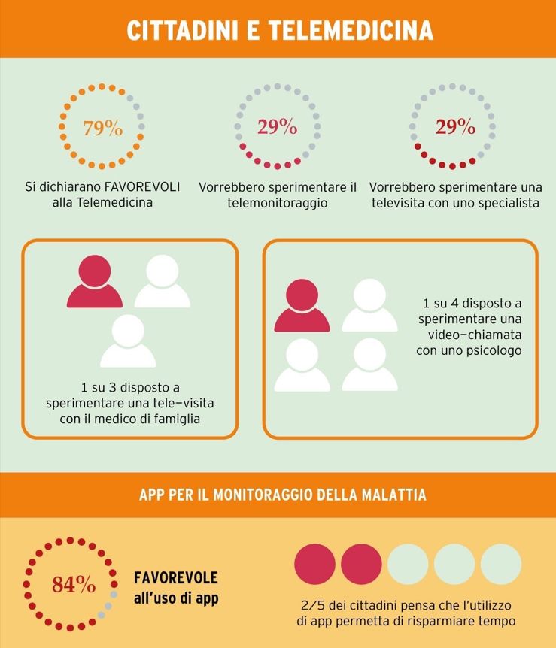
The propensity to use technology in seniors
Source: Osservatorio Innovazione Digitale in Sanità of School of Management - politecnico di Milano - Health Report 2020 gruppo Stada
30.000 citizens over 65 in 15 European countries.

Slide 10
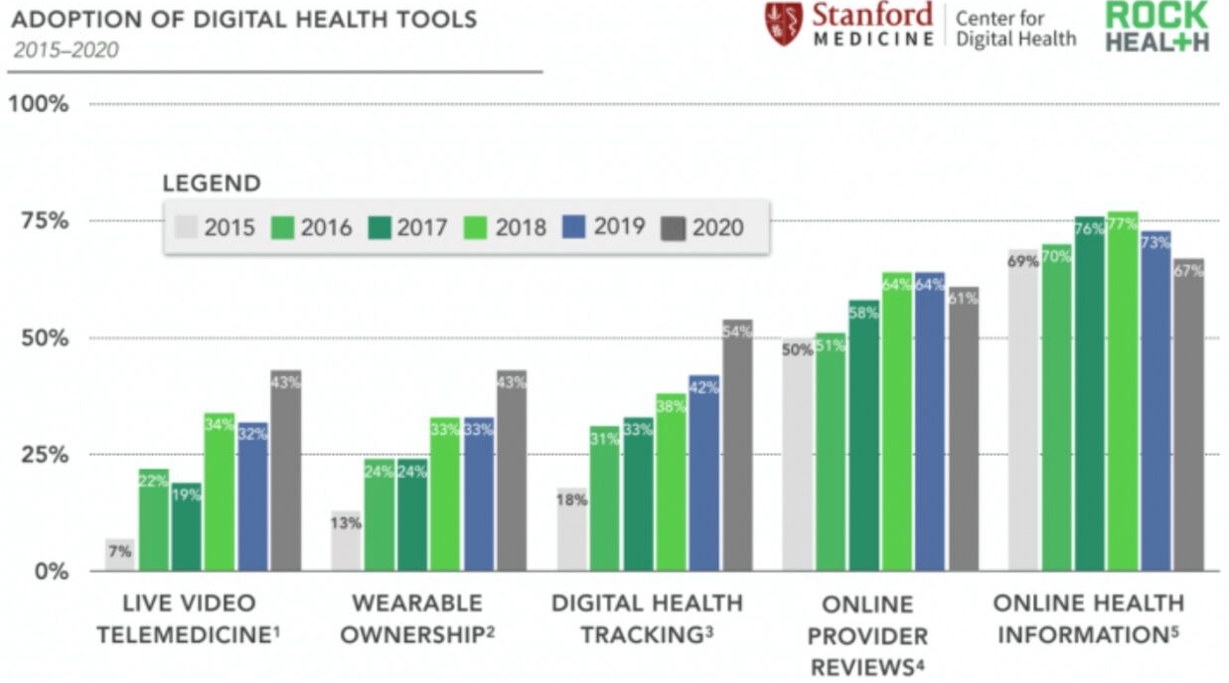

Slide 11
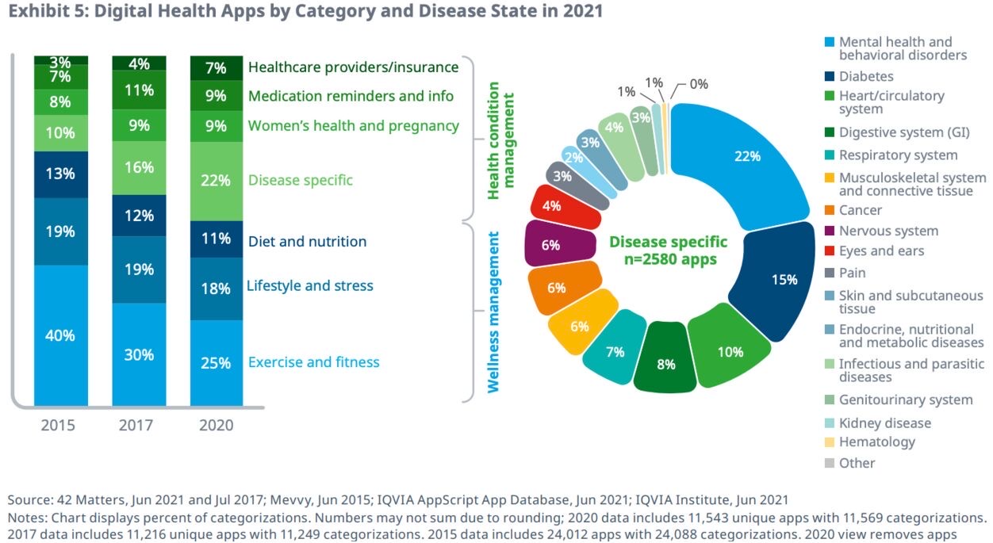

Slide 12
Some transformative technologies of care

Slide 13
Some possibilities offered by artificial intelligence:
Vocal features of interest:
-Selected vocal features that differ in Alzheimer's disease:
-Information content: Reduced number of correctly described items in image description tasks.
-Consistency: Reduced semantic correlation of descriptions with stimulus images
-Repetition: More similar or repetitive utterances
-Use of prepositions: Reduced use of prepositions, which are relational words such as 'on', 'above' or 'below’.
-Use of pronouns: Increased use of pronouns such as "this", "that" or "is".

Slide 14
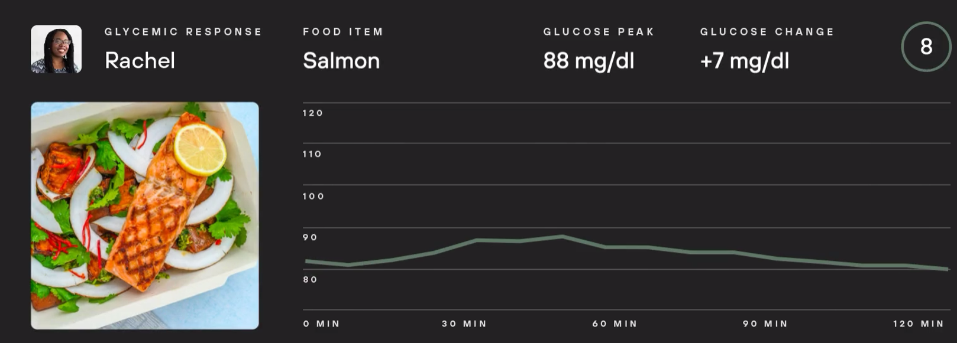
Some possibilities offered by artificial intelligence:
Metabolism is life.
Metabolic health regulates sleep, appetite, weight and energy levels. Levels helps you optimise this to live a longer, fuller and healthier life.

Slide 15
Smart homes as a tool for prevention, wellness and rehabilitation:

Slide 16
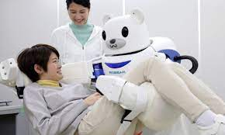
Robotics and interaction with environmental and wearable sensors:

Slide 17
Which factors lead to the success of digital transformation?

Slide 18
International comparative study (17 countries) in 2021 on digital health implementation strategies

Slide 19
Outcomes:
Smaller country size
Presence of a national strategy
Presence of IT interoperability standards
Presence of massive dedicated funding
Centralization of forms of health governance
Absence of corporatism among the professions
Few actors and institutions with veto power to innovation

Slide 20
Which are the limiting factors?

Slide 21
Connectivity infrastructure
Digital skills gap between citizens and service providers
GDPR and its rigid application
Lack of integration among services
Lack of creation of centralized data lakes
Lack of organizational models redesigning assistance

Slide 22
Which new paradigm?
Hybrid Care

Slide 23
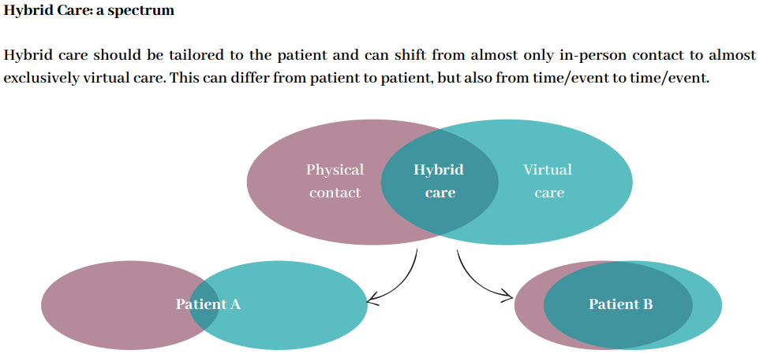

Slide 24
An example of European projects in this direction: The H2020 ValueCare Project

Slide 26
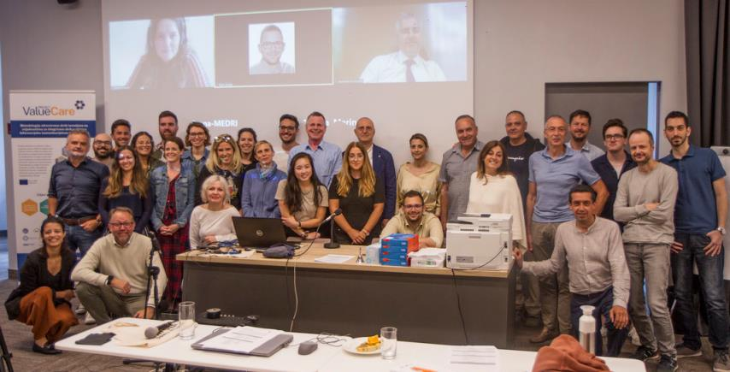
ValueCareProject Consortium
17 partners from 8 EU countries coordinated by the Erasmus Medical Centre (NL)

Slide 27
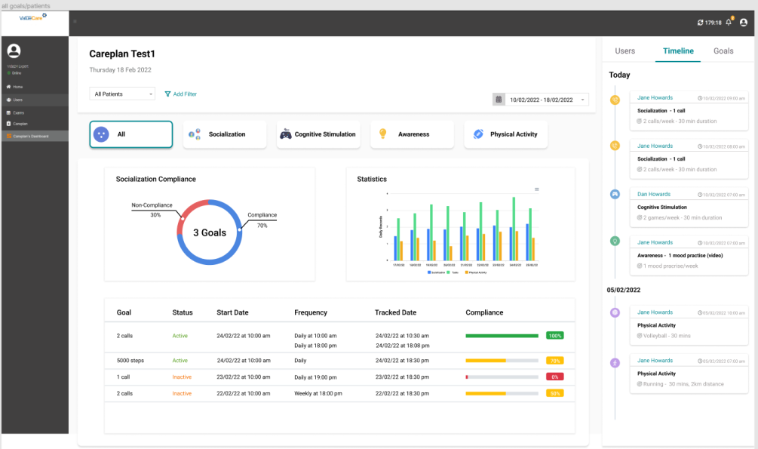
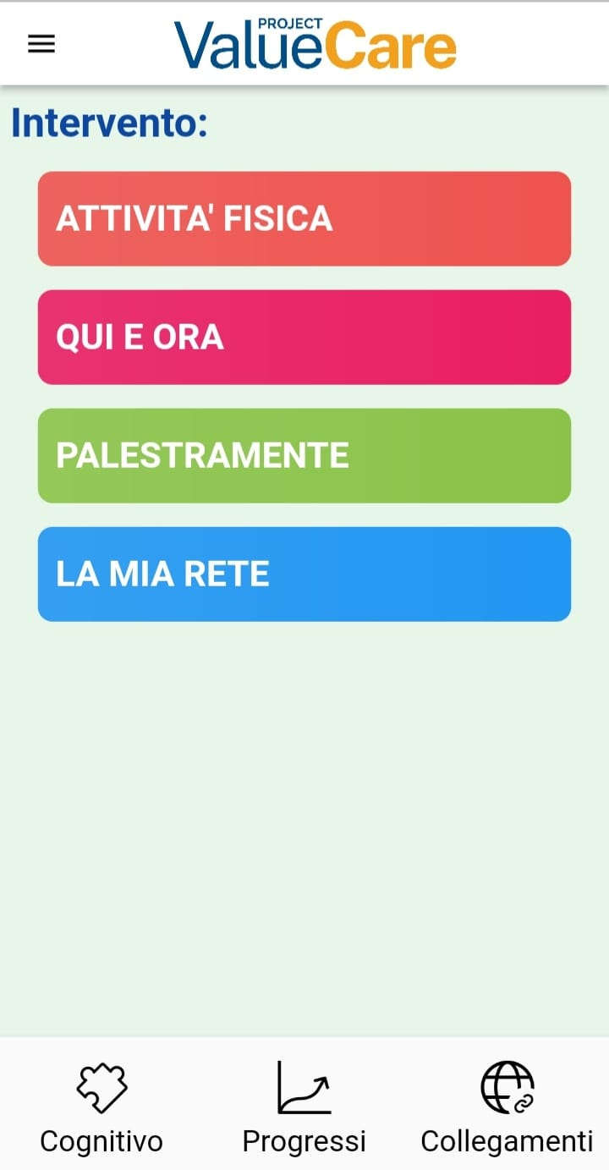
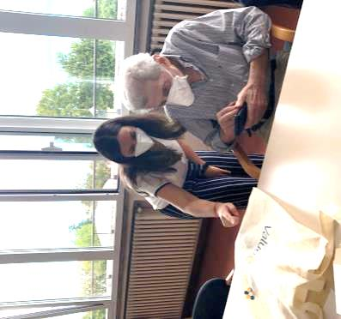
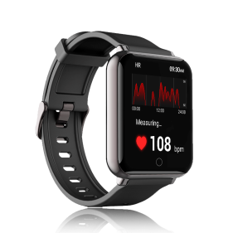
Summary of Technological solutions in ValueCare
These three tools complement each other and make it possible to provide the patient with personalized and constantly updated support
Web dashboard
ValueCare app & virtual coach
Smartwatch

Slide 28
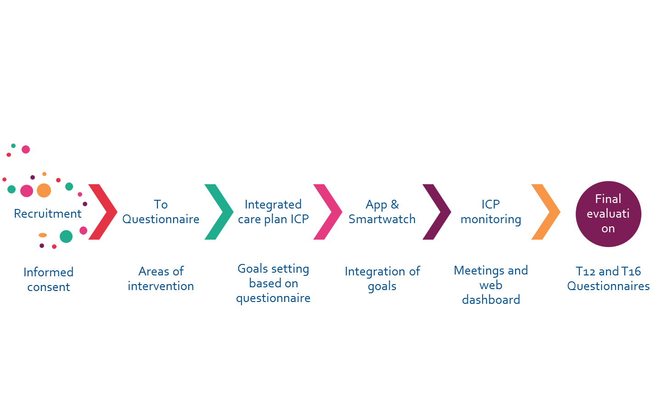
In a nutshell: patient’s journey ValueCare

Slide 29
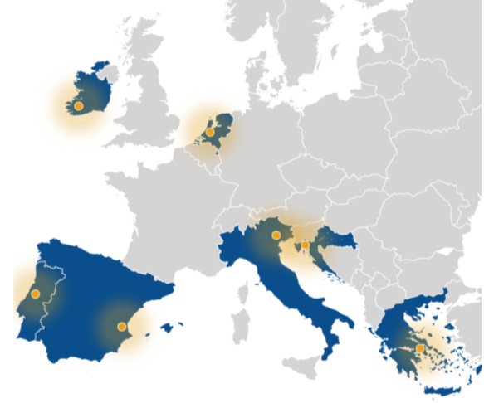
7 pilot sites
Rotterdam
Cork/Kerry
Coimbra
Valencia
Rijeka
Athens
Treviso

Slide 30
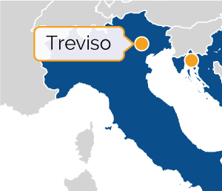
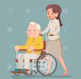
Treviso pilot
Target group: 240 older people diagnosed with MCI (Mild Cognitive Impairment) and a subgroup with diabetes II and hypertension
120 treatment + 120 control
50/70 caregivers
30/40 healthcare professionals
5/10 managers

Slide 31
Thanks
Oscar Zanutto
faber@israa.it

