Slide 1
PROCAREFUL
PRO.active CARE F.or U.sers L.ife
CE0100187
Wien | 22th March 2023
Project Coordinator Oscar Zanutto (I.S.R.A.A.) faber@israa.it

Slide 2
PROCAREFUL PROJECT AGENDA
Implementation
Pilots
Objectives


Targets
ICT Platform
Partners

Slide 3
PROCAREFUL OBJECTIVES
To enable home care providers to scale up their services for older and vulnerable people,
by using ICT solutions based on Machine Learning and Artificial Intelligence to move social and health care services from a reactive
to a proactive approach.

Slide 4
PROCAREFUL PROJECT
Target people
Older people at risk of mental health
illness and physical decline
Carers
Practitioners
Policy makers

Slide 5
PROCAREFUL PROJECT
PROCAREFUL work plan
Benchmarking and ranking
of existing e-care and
m-health solutions
Co-design activities with key stakeholders to design an hybrid
care model that can be contextualized in different rural CE areas
Testing of the
PROCAREFUL Model and ICT Platform
Policy strategy for the hybrid home care model adoption in the CE area

Slide 6
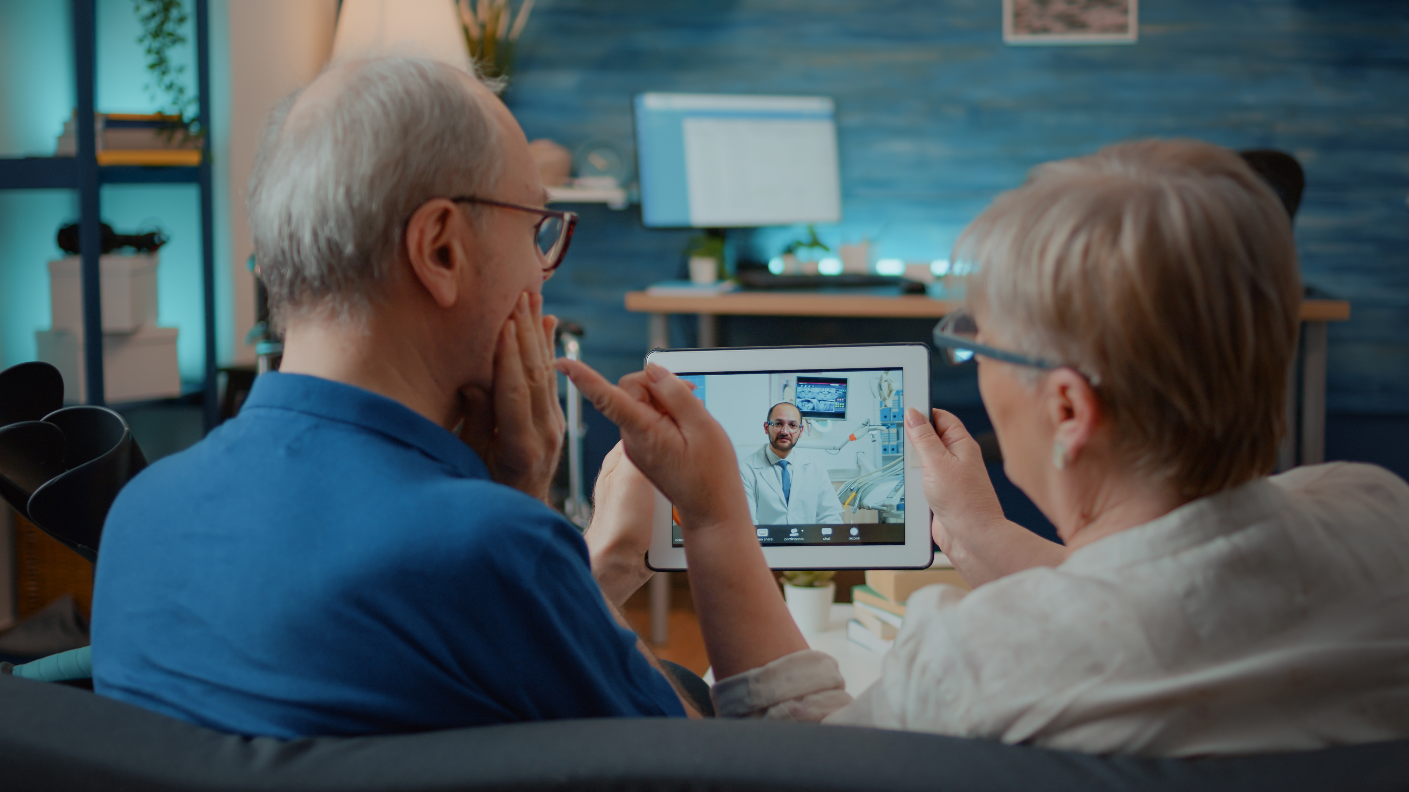
PROCAREFUL PROJECT
PROCAREFUL ICT platform
The ICT platform, supported by Machine Learning and Artificial Intelligence will take into account inputs from co-design activities to allow the delivery of hybrid care.

Slide 7
PROCAREFUL PROJECT
PILOTS
The deployment of the PROCAREFUL Model is tested in
5 home care services.
Pilot site Partner (12 months) | Users (135 total)
ISRAA, Silea-TV (IT) | 30
WWBW, Baden Wurttenberg (DE) | 30
OIC, Lublin (PL) | 30
MI, Split (HR) | 30
OLD, Log Dragomer (SI) | 15

Slide 8
PROCAREFUL PROJECT
Project Partners
Nine partners from Italy, Croatia, Germany, Hungary, Poland and Slovenia

Slide 9
PROCAREFUL
Via Noalese 40, Treviso
www.interreg-central.eu/projects/procareful
faber@israa.it
+39 0422 414517
facebook.com/profile.php?id=100090623695002
linkedin.com/company/procareful/

