Slide 1
Technology, artificial intelligence. Rare diseases and disabilities
Dott.ssa Giulia volpato
REFERENTE eRN skYN, ESPERTO IN PATIENT ADVOCACY, PRESIDENTE ASS.NE P SINDROME EEC INTERNATIONAL APS

Slide 2
Society's disinterest
It tends to isolate the individual affected by a handicap
The individual affected by visual impairment often finds obstacles and barriers on a psychological and physical level;
A lack of knowledge limits the opportunity to adapt daily environments to the needs of individuals;
If I ask someone to read what is written, he makes fun of me and remarks: “but how can you not read??”

Slide 3
Technology, artificial intelligence and disability
In the world of disabilities, artificial intelligence and technology represent an essential instrument for guaranteeing a "normal" daily life.
The so-called aids become an integral part of the life of a disabled person/ rare disease patient:
Reading aids (zoomtext, voiceover, screanreader, etc);
Communication aids (optical readers, communicators for ALS patients, etc.);
Aids for cognitive delay;
Others;

Slide 4
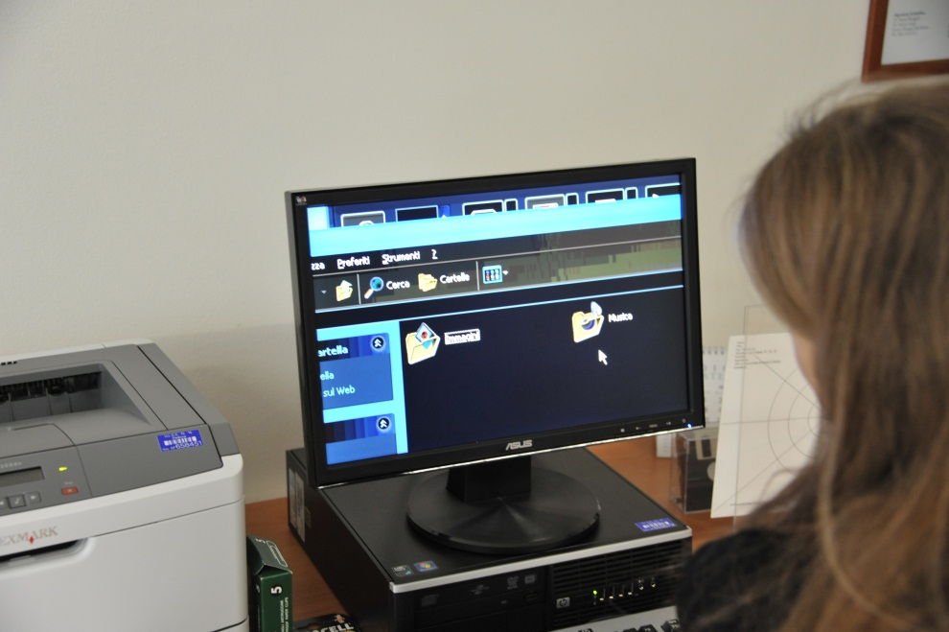
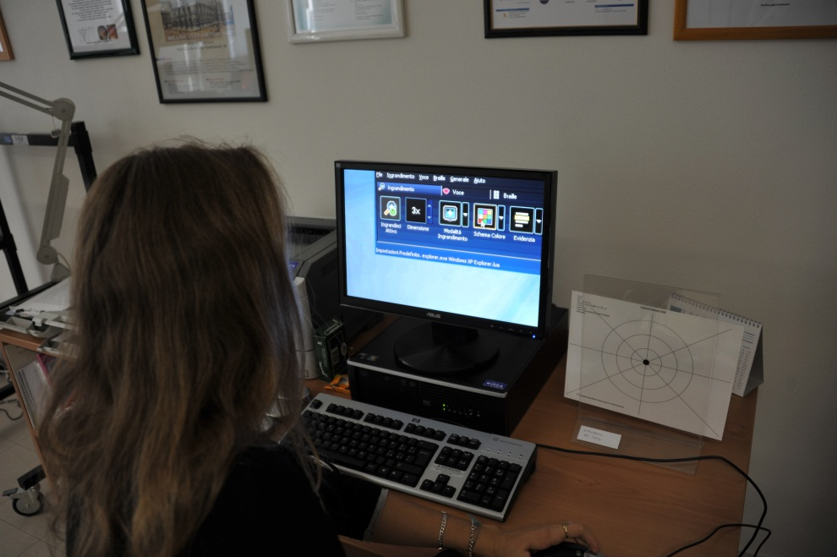
Aids: zoomtext software

Slide 5
Aids: Portable video magnifier

Slide 6
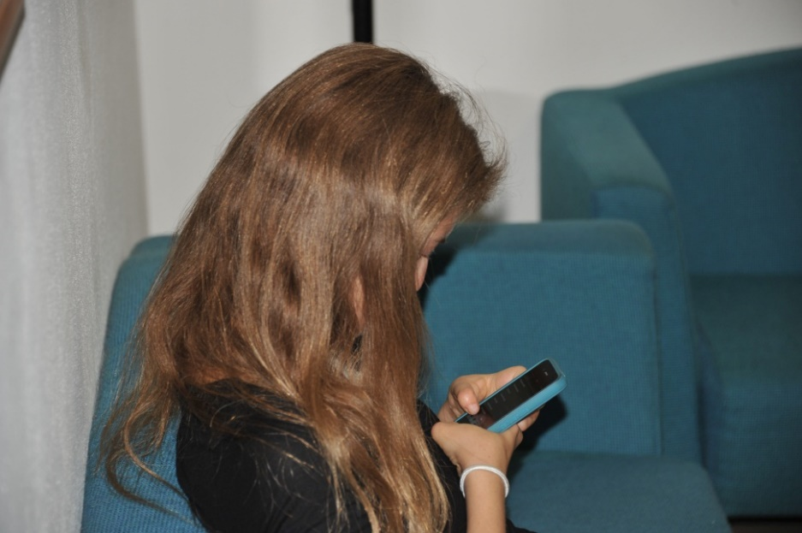
Aids: zoomtext, voiceover, smartphone

Slide 7
Artificial Intelligence: aids for autism

Slide 8
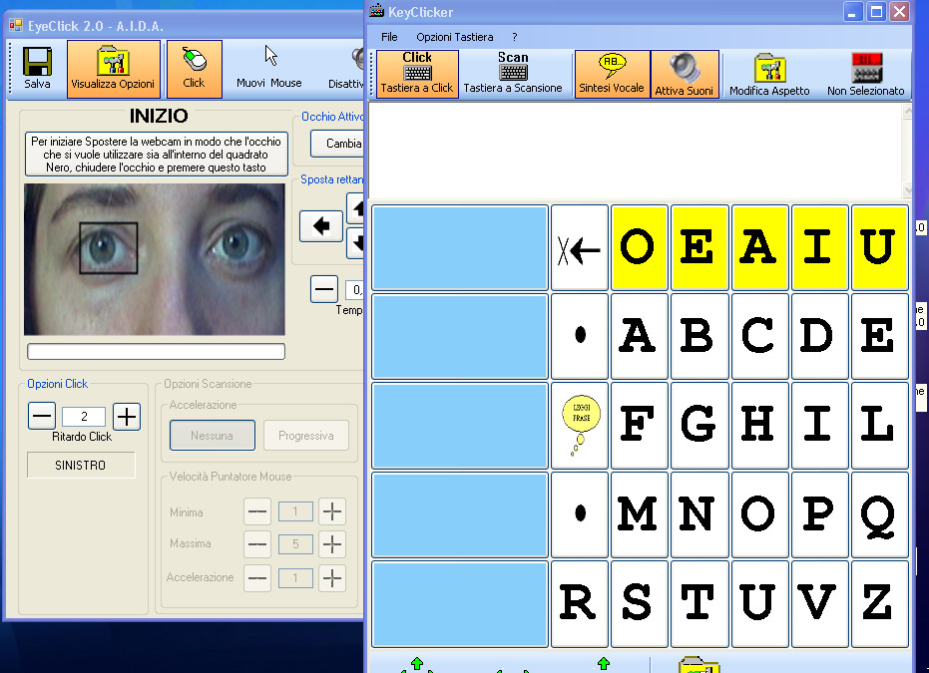
Technology, artificial intelligence and disability: Opportunities for independent living
Aids can be considered as instruments that act and support:
Reading;
Movement and mobility;
Living environments:
Work;
Daily autonomy;
Sport.

Slide 9
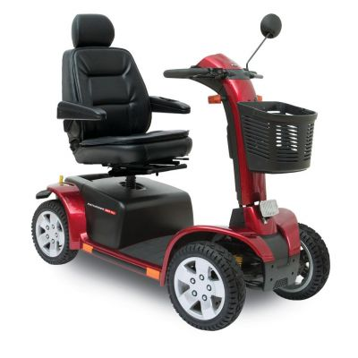
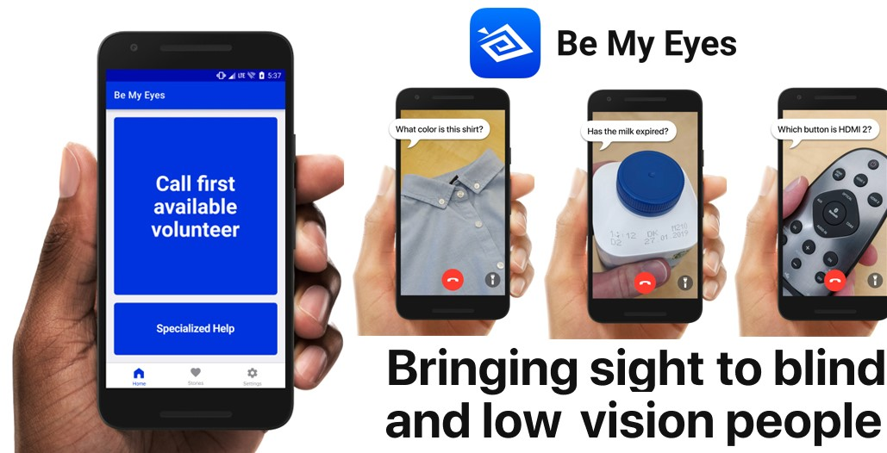
Technology, artificial intelligence and disability
Orientation
and Mobility

Slide 10
Technology, artificial intelligence and disability
Sport

Slide 11
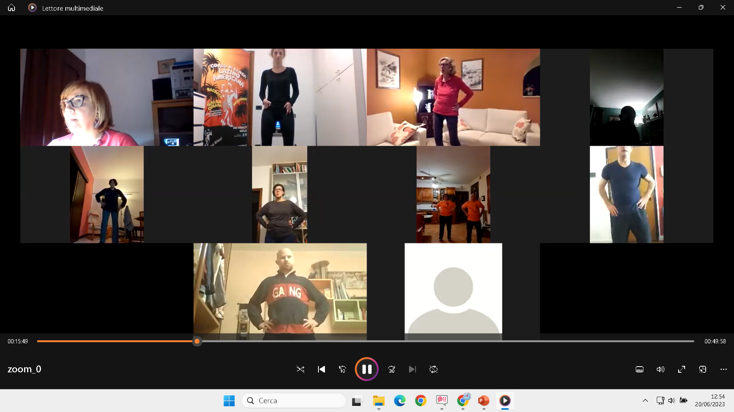
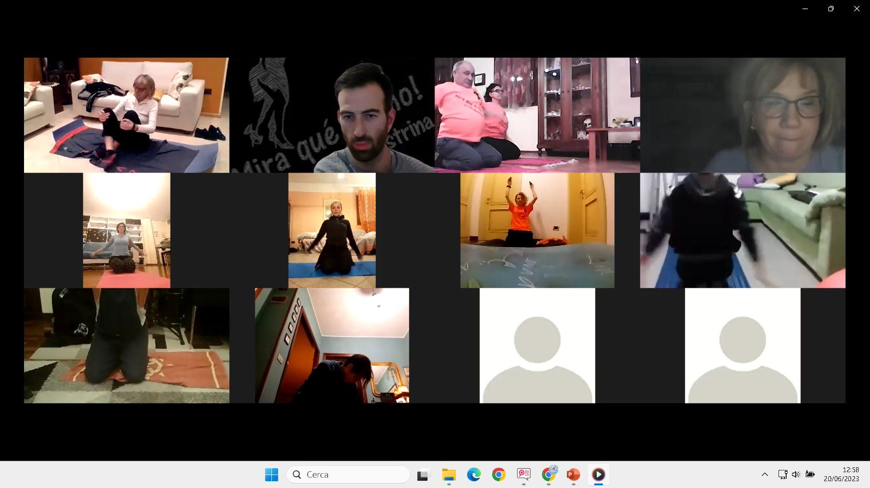
Technology, artificial intelligence and disability

Slide 12
RAREDUCANDO EDUCAZIONE DIGITALE
31 October 2022 – FINAL EVENT
Results presentation
Dott.ssa Giulia Volpato –
President Ass. p63 Sindrome E.E.C. INTERNATIONAL APS ONLUs

Slide 13
R.E.D. Goals
Spread information for an adequate inclusion of children with rare diseases at school (Italy - Greece - Europe)
Provide the tools for a better approach to disability also for trainers and parents
Use of digital technologies for an accessible and innovative inclusive training project
An e-learning project developed on direct experience aimed for the 6-14 age group
Developed through e-twinning platform, epale, edmodo and moodle;
R.E.D. is:

Slide 14
The staff of R.E.D.
The team of operators involved (divided by skills, transversal in practice) in the project consists of:
Health law experts, educator-trainers, geneticist-doctors, human rights experts;
Pharmacist;
Psychologists, informed patients, social workers;
Human rights experts;
Computer engineers and network experts;
Patient associations and institutional referents;

Slide 15
RAREDUCANDO EDUCAZIONE DIGITALE: Training Course
The project:
11 e-learning training sessions aimed at teachers with students ages 6 to 14 and parents;
Teachers will introduce their students to the topic of "rare diseases", treating it (based on the reference age) at a genetic-scientific level (implementation of the ministerial plan of the natural sciences programme);
Administration, to the participants, of a preliminary knowledge assessment questionnaire in order to record the perception of the theme of rare diseases, but above all discrimination also in the classroom;

Slide 16
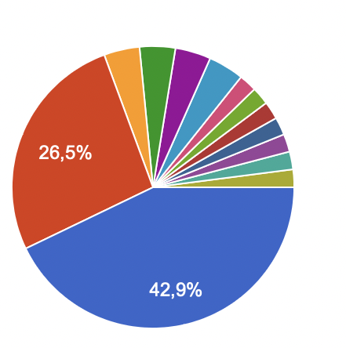
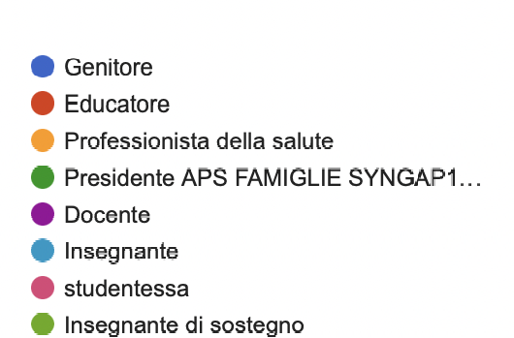
The example, to which the data presented refers to, is made up of:
-50 people who participated to the e-learning course divided as follows:

Slide 17
Digital education and school, conflicting or complementary themes?

Slide 18
What do you think of digital education at school?

Slide 19
Is digital education at school also needed to promote accessibility to studying, in particular for children with rare diseases?

Slide 20
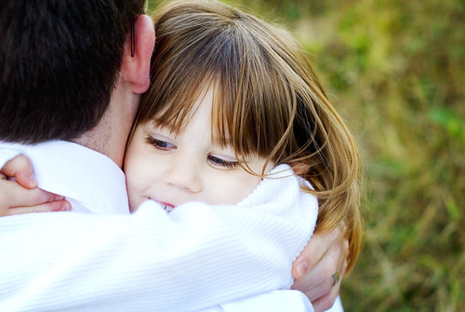
Future opportunities for Artificial intelligence:
risks?
Questa foto di Autore sconosciuto è concesso in licenza da CC BY-ND

Slide 21
Rare diseases, Covid-19 and social distancing:

Slide 22
Social needs

Slide 23
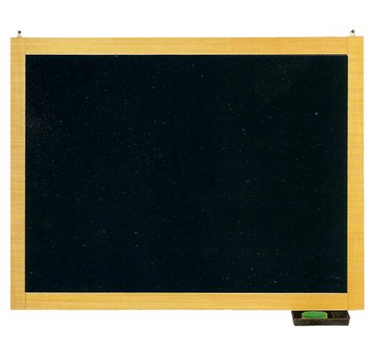
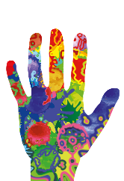
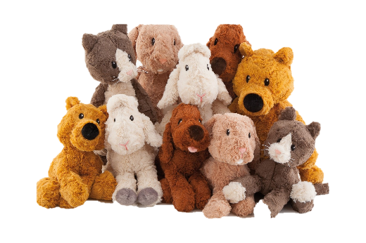
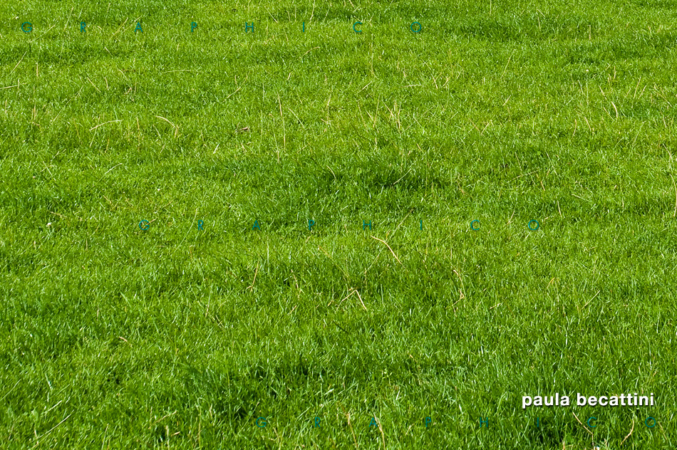
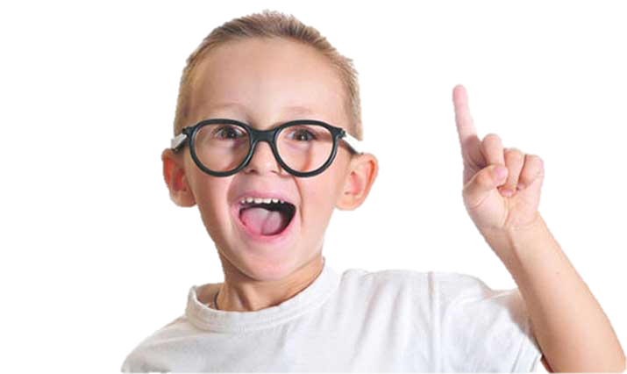
5° A F. BARACCA
RI-TROVO AMICIZIA

Slide 24
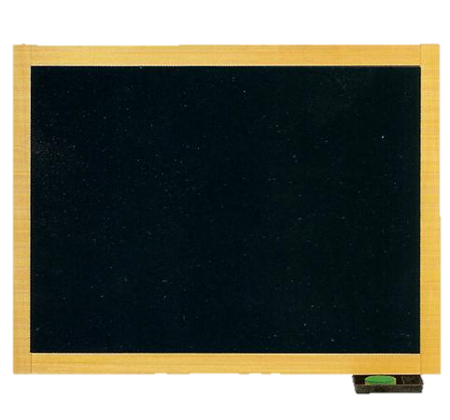
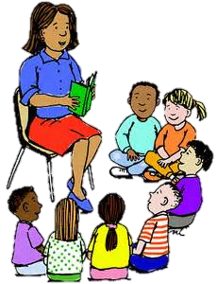
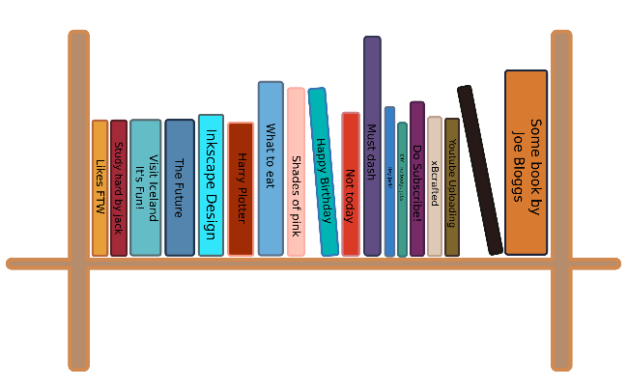
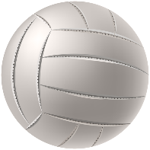
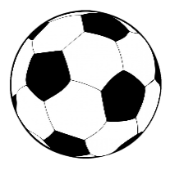
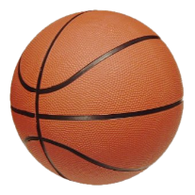
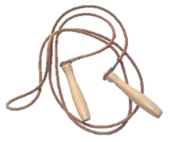
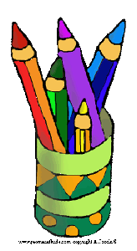
friendship
welcoming
5°AB DUCA D’AOSTA
integration
games
fun
group
team work

