Slide 1
ENSA Working Group
CARES
Kujawsko-Pomorskie Region
Poland
Beata Skowrońska
Regional Represenation of Kujawsko-Pomorskie

Slide 2
Project idea
CARES
Polish title: Teleopieka dla starzejącej się Europy
• Policy objective: A Europe with a stronger social dimension
• Specific objective: Healthcare
• Total budget EFRR: 1,5 mln EUR
• Project approved on 13th December 2022
• Project’s duration: 1st March 2023 – 28th February 2027
Remote Healthcare for Silver Europe

Slide 3
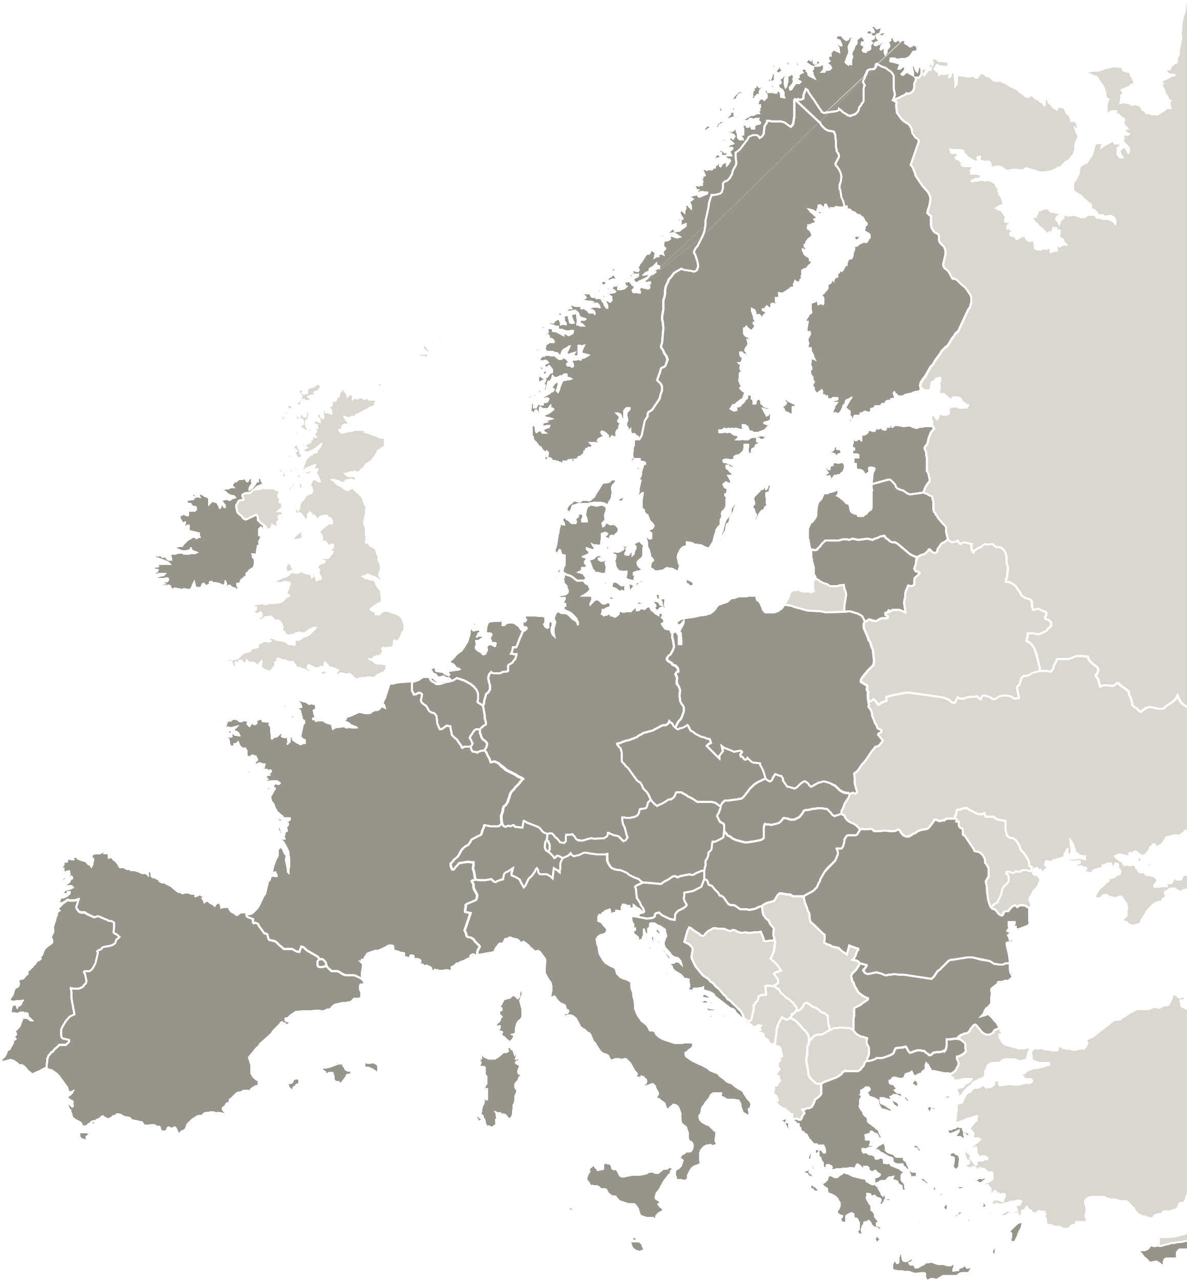
PROJECT PARTNERS
Kujawsko-Pomorskie Voivodeship, Poland – Lead Partner
Gérontopôle Nouvelle-Aquitaine, Francja
Office of the Regional Government of Styria, (Österreich) Austria
Southern Denmark Region, Denmark
The R&D center the municipality of Linköping, Sweden (Sverige)
ULSS7 Pedemontana Agency, Italy
Aragón Healthcare Service – SALUD, Spain
City of Zagreb, Croatia (Hrvatska)
Nouvelle-Aquitaine Region, France
Veneto Region, Italy
Associated Partners

Slide 4
Project CARES objective
CARES aims to improve policy instruments of the participating regions in order to specialize and disseminate telemedicine and telecare services for older people and people with limitations by changing or enhancing these services
How?
•Exchange of experience & capacity building through identification and transfer of good practices
What is a good practice?
• A policy-related initiative
• Proved to be successful in a region
• Potential source of inspiration for other regions
Where? • international seminars
• workshops, peer reviews
• study visits to partner regions,
• cooperation with experts and with a group of stakeholders

Slide 5
Project CARES # key words
The core project topic: telemedicine and telecare for silver society and people with limitations
#Telemedicine a health-related service with the help of telecommunicating and electronic information technologies. It covers teleconsultation, tele-expertise, telemonitoring, teleassistance, remote medical first response (emergency services).
#Telecare is technology-based healthcare so that people may remain safe and independent in their own homes. Devices include apps or technologies that issue early warning and detection as well as sensors which can provide support for people with illnesses such as dementia, or people at risk of falling.
#e-Health covers telemedicine as well as telecare (mobile health applications and connected health objects). “WHO defines eHealth as the cost-effective and secure use of information and communications technologies in support of health and health-related fields, including health-care services, health surveillance, health literature, and health education, knowledge and research.”

Slide 6
What are the thematic areas of the good practices in CARES?
1.
Increased accessibility of services
> Increased availability of telecare and telemedicine services for peripheral areas
2.
Modern tools
> Widespread use of innovative digital tools enabling prevention, health promotion, monitoring and medical diagnosis of older people
3.
Increased institutional capacity & educated medical staff (management platforms, coordination centres, staff trainings)

Slide 7
Nouvell-Aquitaine - France
Local Stakeholders Group
Stakeholders play a vital role in the proces of the project’s implementation:
influence on key decisions in the project
diagnosis of needs for telemedicine and telecare services at regional level
identification of good practices from the region/country
exchange of knowledge and experience with foreign partners
enhance their capacity or capabilities related to telemedicine and telecare services
Kujawsko-Pomorskie Region - Poland
City of Zagreb - Croatia

Slide 8
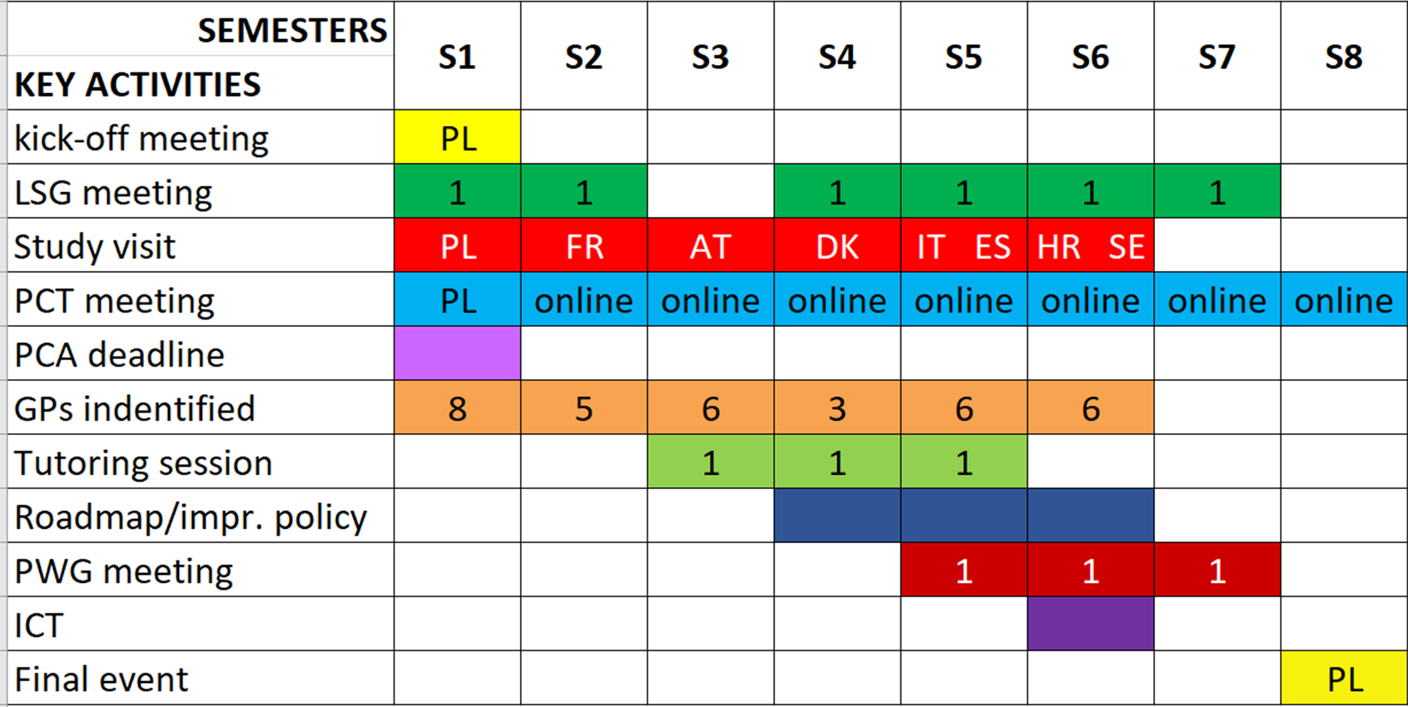
Project CARES activities

Slide 10
Kuyavian-Pomeranian
Telecare

Slide 11
KUYAVIAN-POMERANIAN
VOIVODESHIP POPULATION FORECAST
BY AGE GROUPS
pre-working age working age post-working age
Source : Study by the Central Statistical Office (GUS) - Population forecast of communes for 2017-2030 (experimental study) 2017

Slide 12
IS A SUPPORTIVE, ALTERNATIVE CARE SERVICE USING MODERN TECHNOLOGIES.
ITS AIM IS TO INCREASE THE SAFETY OF THE ELDERLY, DISABLED, SICK AND OTHER PEOPLE STAYING IN THEIR HOMES.
TELECARE
Source: https://pl.wikipedia.org/wiki/Teleopieka

Slide 14
ALARM NECK PENDANTS
CARBON MONOXIDE DETECTORS
MOTION SENSORS
WRIST BANDS
GAS DETECTORS

Slide 16
SOS BUTTON - used to send SOS alarm and make a voice call with Call Center staff in case of danger to life or health.
HEART RATE MEASUREMENT - is made automatically by the sensor on the underside of the wristband. The measurement value is send directly to the Call Center, where, if an abnormality is detected, the Call Center staff will attempt to contact the User, or designated family members, caregivers or neighbors.
DEVICE FUNCTIONS:
FALL DETECTOR - detects a fall followed by the User's immobility, after which a signal is sent to the Call Center staff. However, if only the User is able to press the SOS button, he should always do that, without waiting for automatic detection.
GPS LOCATION - the device has a built-in GPS transmitter. In case of SOS alarm sent by the User, the Call Center staff will know where the User is at the moment and where the help should be send. Furterhmore, in the event of loss of orientation in the field by the User of the wristband, it will be possible to determine its location via the Call Center.
TWO-WAY COMMUNICATION - the wristband has a built-in SIM card with an individual phone number, which allows family members/caregivers to contact quickly with the user by the wristband phone number.

Slide 17
Kuyavian-Pomeranian Telecare
”Serene Autumn of Life
in Kuyavia and Pomerania”
TELECARE

Slide 18
The "Kuyavian-Pomeranian Telecare" project is a partnership between the Kuyavian-Pomeranian Voivodeship, the Kuyavian-Pomeranian Digital Competence Center - Conectio and 87 communes of the Kuyavian-Pomeranian Voivodeship.
The aim of the project is to increase access to social services, provided in the local environment in the form of neighborhood help, care volunteering and modern technologies such as telecare for the 3000 inhabitants of the Kuyavian-PomeranianVoivodeship who need support in the daily functioning.
The project is being implemented from 2021 to 2023 and is co-financed by European Funds, the overall budget of the project is over 23 milion zloties, of which over 19 millions is co-financed by the European Union.

Slide 19
KUYAVIAN-POMERANIAN TELECARE
CALL-CENTER

Slide 20
KUYAVIAN-POMERANIAN TELECARE

Slide 21
KUYAVIAN-POMERANIAN TELECARE

Slide 22
COMUNICATION SYSTEM

Slide 23
Mr. Henry - user
He is very pleased with the device. „I feel safer and more confident now that I have the wristband.”
Mrs. Stanisława - user
She can't imagine her life without the wristband. She doesn't go anywhere without it. As soon as something disturbing happens to the device, she immediately contacts the Call Center to check if the wristband is working properly.”
Mr. Andrew – user
„The doctor advised me to move. I walk almost every day, for example in the forest with poles, about 7 kilometers a day. Wearing the wristband, I feel like I'm walking with someone next to me."
USER’S OPINION
Mrs. Halina - user
“This is the only chance for old, lonely and sick people. Because, sometimes, you fall and you can't even move. When you have a serious back pain, you cannot move. Then you press the button on the wristband and you get help. Otherwise, a tragedy could happen."
Ms. Anna – user's daughter
„The wristband provides a sense of security for our whole family. My husband and I feel comfortable that we can go to work and mom is taken care of, at that time, someone is watching over her.”

Slide 24
Total amount of rescue calls
SOS alarms
Fall alarms
Amount of interventions
Emergency services calls
Designated guardians calls
791
424
367
20
14
6
LIST OF INTERVENTIONS MAY 2023

Slide 25
CARDIOLOGICAL COMPONENT

Slide 26
STAKEHOLDER GROUP
Social Services Center in Toruń
District Chamber of Nurses and Midwives in Toruń
Kuyavian-Pomeranian Agricultural Advisory Center in Minikowo
Kuyavian-Pomeranian Provincial Board of the Polish Committee for Social Welfare
Polish Red Cross. Kuyavian-Pomeranian Regional Branch
Sue Ryder Association
Cardiologist
Regional Center for Social Policy in Toruń
Nicolaus Copernicus University
Department of Fundamentals of Clinical Skills and Postgraduate Education of Nurses and Midwives, Faculty of Health Sciences, Collegium Medicum,
Center for Academic Entrepreneurship and Technology Transfer,
Interdisciplinary Center of Modern Technologies
Academic Research Center AKAMED,
Department of Applied Computer Science, Institute of Technical Sciences Faculty of Physics, Astronomy and Applied Computer Science.
Toruń Regional Development Agency
Kuyavian-Pomeranian Digital Competence Center
STAKEHOLDER GROUP
CARES

Slide 27
THANK YOU
FOR YOUR ATTENTION

