Slide 1
ENSA Working group Older Adults and Disability PANDA Conference ENSA Working Group Youth, Child, and Family/Youth Care Platform 27, 28 & 29 June 2023 - Brussels
Efkarpidis Apostolos, R. Nurse,
MSc Health Management, MSc Public Health, PhD(c) Public Health Policies, Deputy Director in General Hospital of Syros, Partner of Altera Vita

Slide 2
Day Care Centers for patients with dementia and Integrated Psychogeriatric Care (INTRINSIC), as good practices of health care services in Greece
TEAM OF AUTHORS
Politis Antonios, Professor of Psychiatry, University of Athens
Efkarpidis Apostolos, R. Nurse, MSc Public Health, PhD (c) Public Health Policies, General Hospital of Syros, Partner of Altera Vita
Petrou Anna, R. Nurse, General Hospital of Syros, MSc.
Aggeletaki Eleftheria , R. Nurse, Physical and Medical Rehabilitation Center, General Hospital of Syros
Sakellariou Miltos, Biologist, MSc Counseling Psychology, Director of Altera Vita, Syros
Daskou Miranta, Biologist, Member of Altera Vita, Syros

Slide 3
Purpose of the presentation
The agenda of the presentation includes
To describe the problems of the National Health System in Greece that create barriers to citizens' access to health care services, especially for people suffering from dementia, and to mention the good practices applied for these patients in Greece.
Some dementia-oriented national health data to understand the big picture
2) Information about Day Care Centers for patients with dementia and
3) Some information about the INTRINSIC program

Slide 4
(1) Problems of the National Health System that pose barriers to citizens' access to health services
The public underfunding of health
The increased burden of out-of-pocket payments (due to the decrease in household income)
Staff shortages
The poor quality of services in the public health sector
The geomorphology of the country and the unequal geographical distribution of health care facilities
The unequal geographical distribution of medical and nursing staff

Slide 5
Total health care expenditure. Expenditure on long-term care services. Out of pocket expenditure in indicative countries of the European Union. Percentage of GDP.
Eurostat, 2022

Slide 6
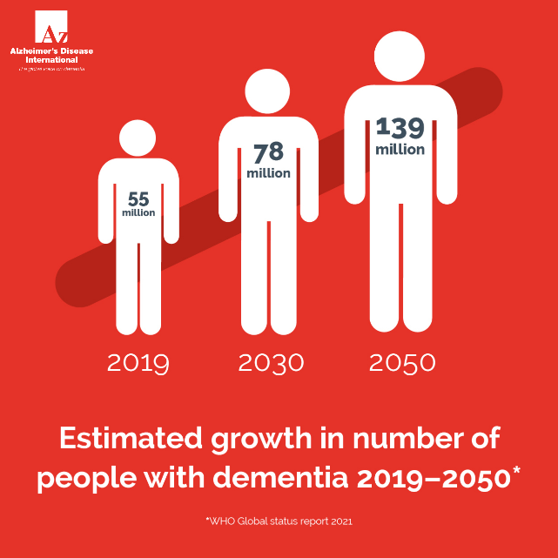
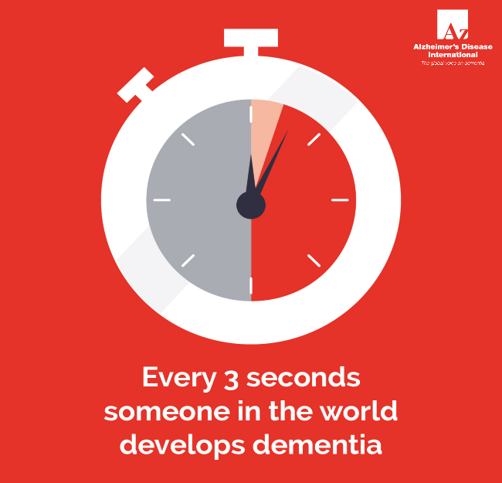
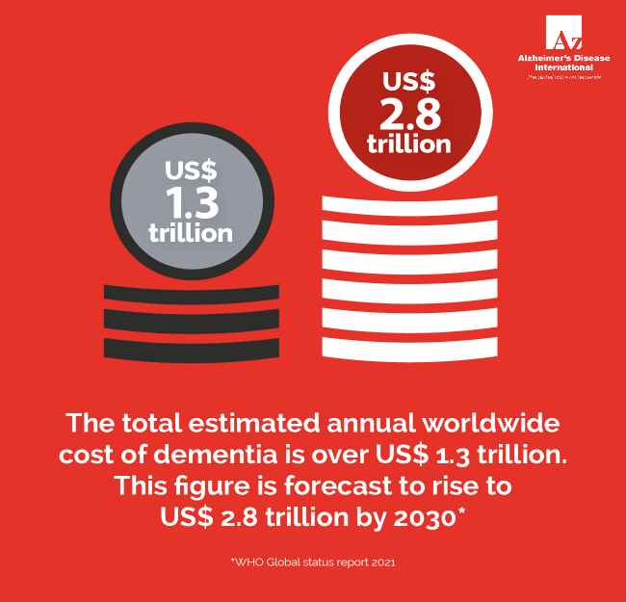
What is happening globally specifically for dementia

Slide 7
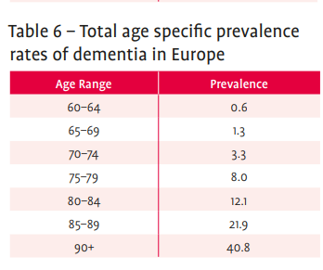
Prevalence of dementia in Europe
In Europe it is estimated that 9.78 million people are living with dementia today.
In the European Union 7.85 million people.
Alzheimer Europe Dementia Yearbook 2019.

Slide 8
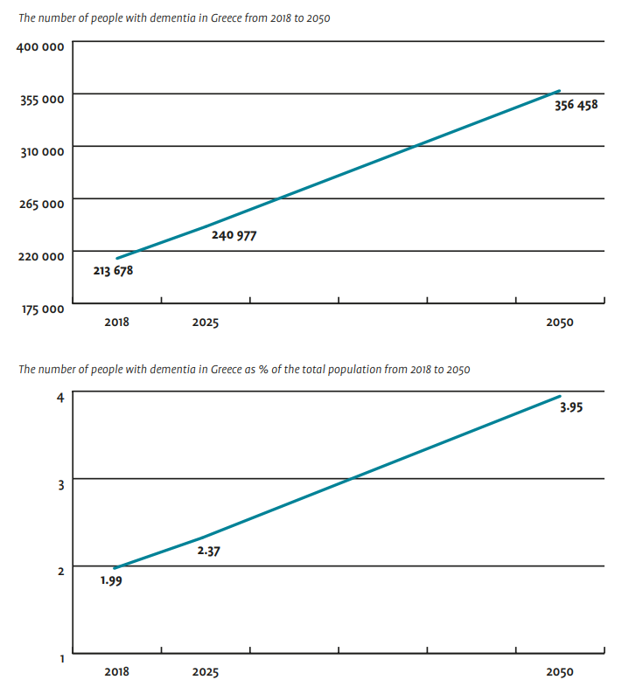
(2) Dementia in Greece
In Greece it is estimated that around 240 thousand people are living with dementia.
Greece has the highest prevalence in the European Union for dementia (2.37% of the population) right after Italy (2.44% of the population).
Alzheimer Europe Dementia Yearbook 2019.

Slide 9
2

Slide 10
The existence of public Day Care Centers for patients with dementia is an existential need for both patients and their caregivers.
The time spent by caregivers at home, in the dependent stage of the patient, has been estimated to be 168 hours per month by a family member and an additional 72 hours per month by a domestic helper.
Totally 240 hours/month or 8 hours/day. (National Dementia Action Plan, 2015-2020)
This creates a great physical, mental, social and also financial burden for caregivers.
In Syros, it is estimated that 250 people are living with dementia, of which 96% are cared for at home, while the remaining percentage reside in nursing homes until death (Bowen, et al, 2016).

Slide 11
What do Dementia Day Care Centers offer?
Dementia Day Care Centers are open approximately 8 hours a day. During these hours, patients are offered:
Neuropsychological and functional assessment – Memory Test
Non-pharmacological therapeutic interventions for people with dementia
Creative occupation, creative play and exercise
Education, information and psychosocial support for caregivers
Free time for caregivers

Slide 12
(3) Τhe INTRINSIC program
INTEGRATED INTERVENTION PSYCHOGERIATRIC CARE (INTRINSIC) services are collaborative mental health telehealth services in primary and secondary health care centers in low-resource areas of Greece.
These are services supported by the country's Ministry of Health and its implementation began in the spring of 2022.
Uses a digital platform, called HERMES to register the psychogeriatric health data of the beneficiary citizens.
The goals are twofold: (a) To offer modern care services facilitating early detection, monitoring and symptom management of people over 65 with memory problems, depression and other psychogeriatric syndromes, who live in remote or inaccessible areas.
(b) To provide training, support and service development opportunities for primary and secondary health care professionals serving in hard-to-reach areas of Greece.

Slide 13
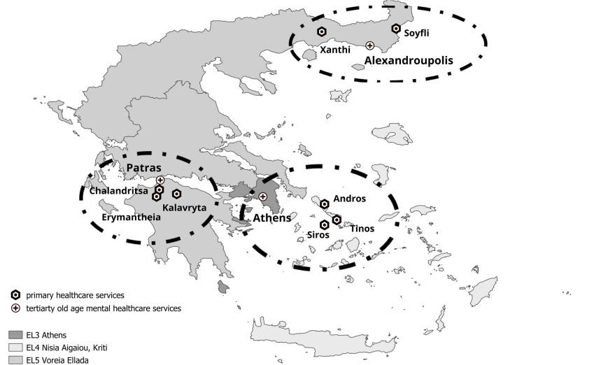

Slide 14
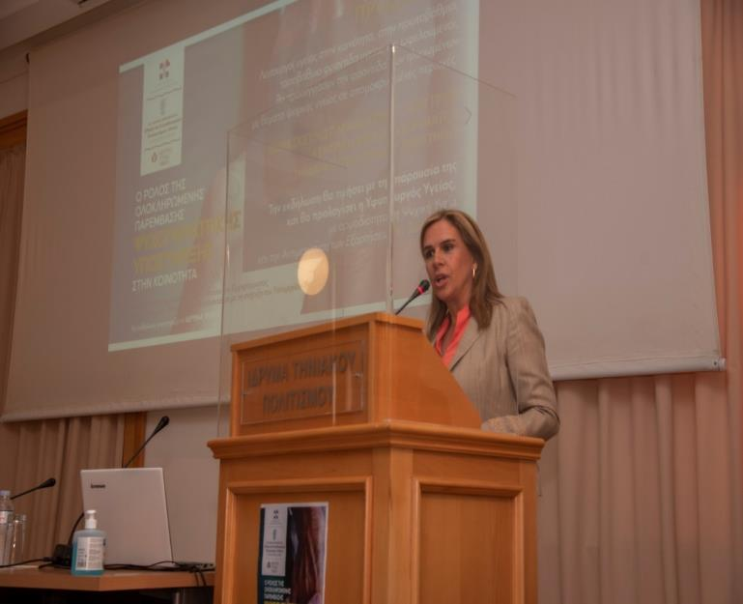
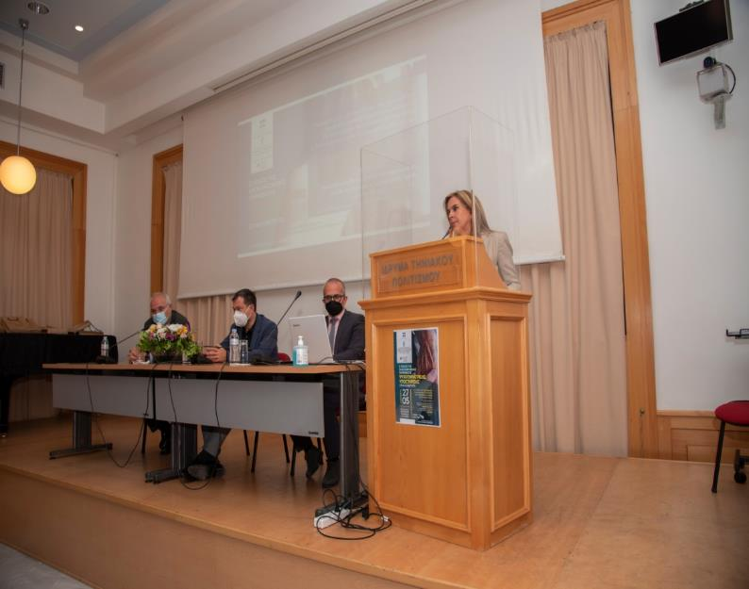
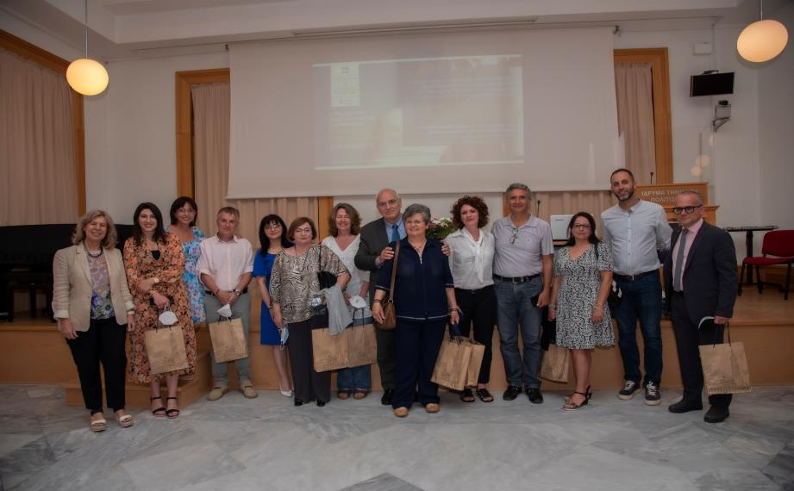

Slide 15
Results from INTRINSIC services
So far more than 500 people have received INTRINSIC services in the places where they are offered.
These people have had a psychogeriatric evaluation,
Their medication has been adjusted where necessary, and
They are being systematically monitored.
The use of INTRINSIC services reduced barriers to old-age mental healthcare, since it contributed to the reduction of time and costs for seeking old-age cognitive-and mental healthcare. It resulted in a significant reduction in the distance (in km) older adults annually travelled to visit health care services and in time (hours) annually spent for travelling and accessing healthcare services due to their old-age mental or neurocognitive disorder and returning home.

Slide 16
The services also include:
Memory booster groups
Caregiver training in the neuropsychiatric symptoms of dementia
Counseling for caregivers
PATH (Problem Adaptation Therapy) a non-pharmacological intervention for citizens suffering from depression.

Slide 17
In conclusion
.
Greece seems to be finding ways for people with psychogeriatric problems to access health care services.
These services are still at a very early stage and in no way cover the needs of the population.
The Day Care Centers for Dementia and the INTRINSIC program it is necessary to extend in all country because can really improve the access to care for these special category of citizens
Strengthening this effort, both through national resources and through programs of European organizations and networks, is vital and very useful for facilitating the access of people with psychogeriatric problems who are living in remote and inaccessible areas of Greece.
The heads of the Universities, The teamwork of our General Hospital of Syros, and τhe Health Centers of Andros and Tinos, and Altera Vita we are working intensively on this.

Slide 18
Thank you again for your kind invitation
And for your attention

